Slide 1
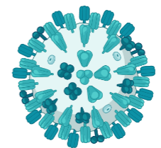



Impact of Host and Vaccine Characteristics on Immune Responses Following Influenza Vaccination
Dissertation proposal by
W. Zane Billings
2023-04-06
Contact info: https://wzbillings.com/

Slide 2


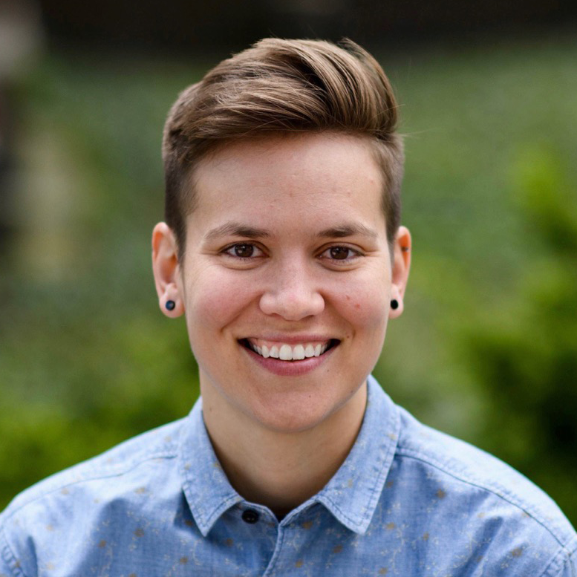


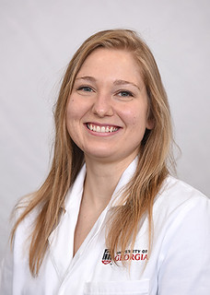





Acknowledgements
Committee
Money
Andreas Handel
Ye Shen
Amy Winter
Natalie Dean
Aim 1
Aim 2
Aim 3
Amanda Skarlupka
Yang Ge
Tzu-Chun Chu
Veronika Zarnitsyna
Savannah Hammerton
Jessica Knight
UGA Infectious Disease Interest Group
IMAG-MSM Immunology Subgroup
CIVIC, CIVR-HRP, CEIRR, CIDER, etc.
Biorender.com
UGA Ross Lab (Ted Ross, Michael Carlock)
Everyone who told Andreas whether they thought
what I was doing was interesting or not

Slide 3
Specific aims
Develop metrics for the quantification of the total immune response to an influenza vaccine, incorporating both magnitude and breadth.
Quantify the role of pre-vaccination titer, prior vaccinations, vaccine dose, and antigenic distance on individual vaccine response.
Explore how age and vaccine dose interact to affect the antibody response.
Notes:
Quickly go through aims to establish why background is important

Slide 4
Overview
General background: motivation, terminology, how do we study this?
Data description
Aim-specific background, preliminary data, and proposed study
Notes:
Transition from aims -> background

Slide 5
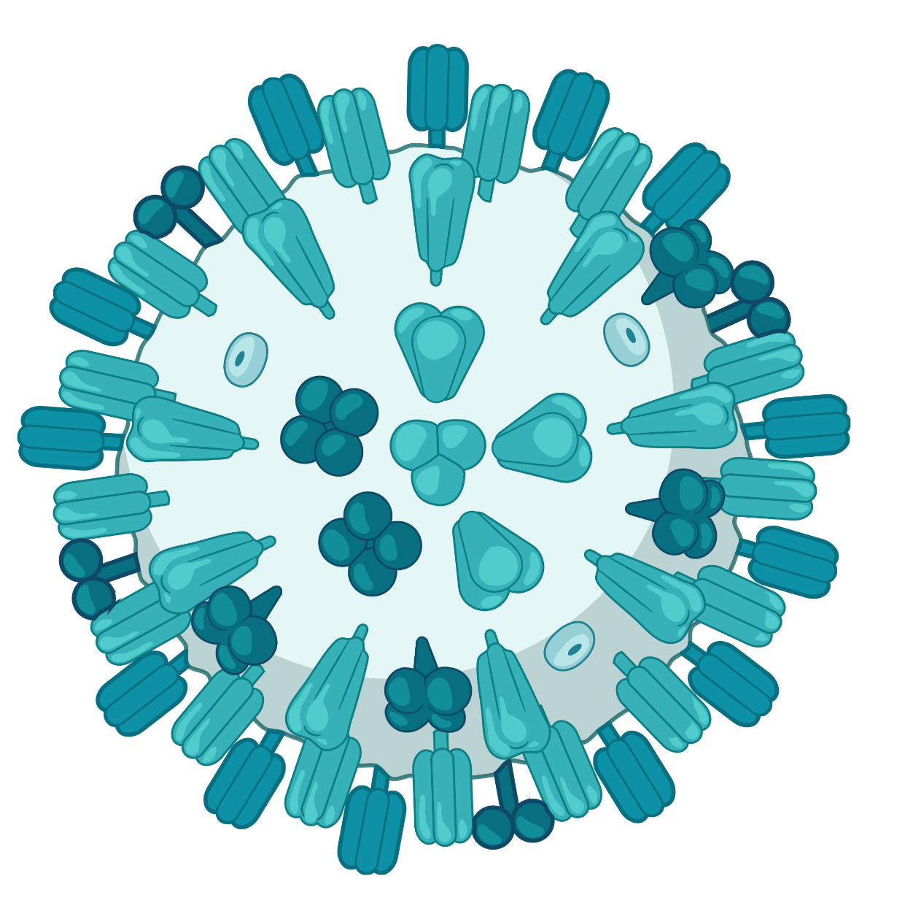
Influenza viruses
(-)SSRNA virus
Segmented genome
Flu A and B are distinct genera that circulate in humans and cause seasonal epidemics
A has a natural animal reservoir in wild waterfowl and can infect domestic poultry and livestock.
Notes:
QUICKLY
Influenza is an enveloped (-)SSRNA virus with a segmented genome.
The virus primarily infects and replicates in lung and throat epithelium.
Left shows the biorender image that I’ll use to represent flu, the big picture is the actual cryo EM image where you can see the viral structure.

Slide 6
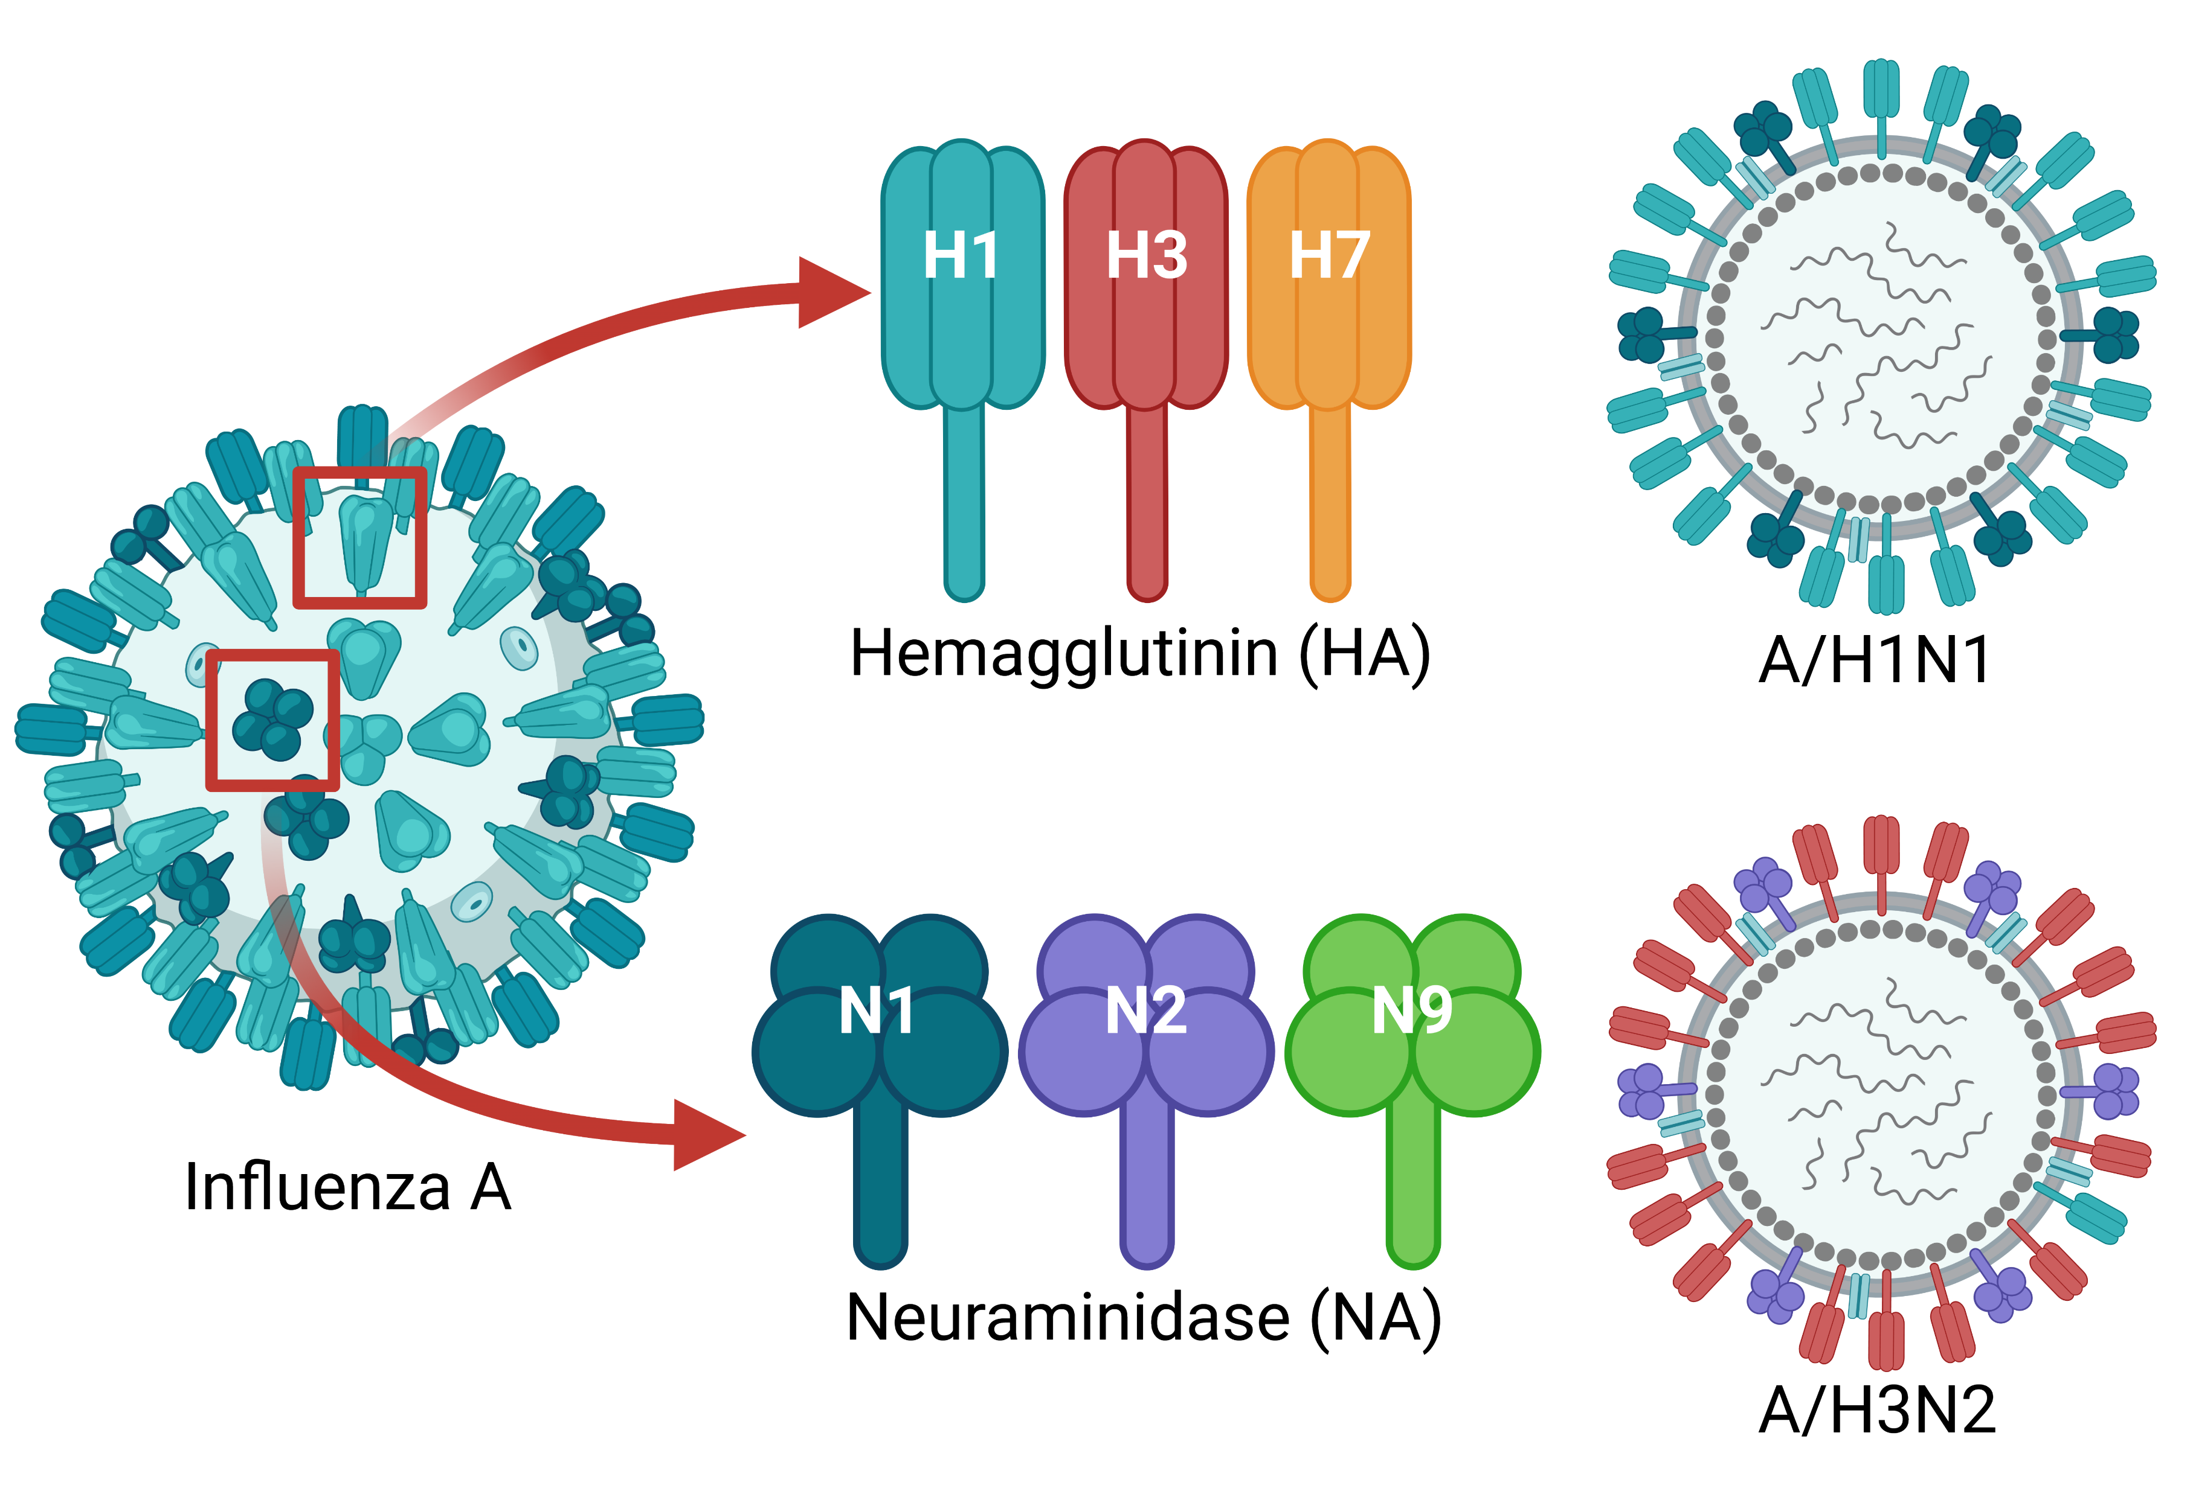
Notes:
The two major viral surface proteins are HA and NA, which have several genetic variants. Recombination of these genetic variants leads to the different “subtypes” of influenza A and lineages of influenza B that circulate in humans. Super important for Flu A, Flu B also changes but slower.

Slide 7
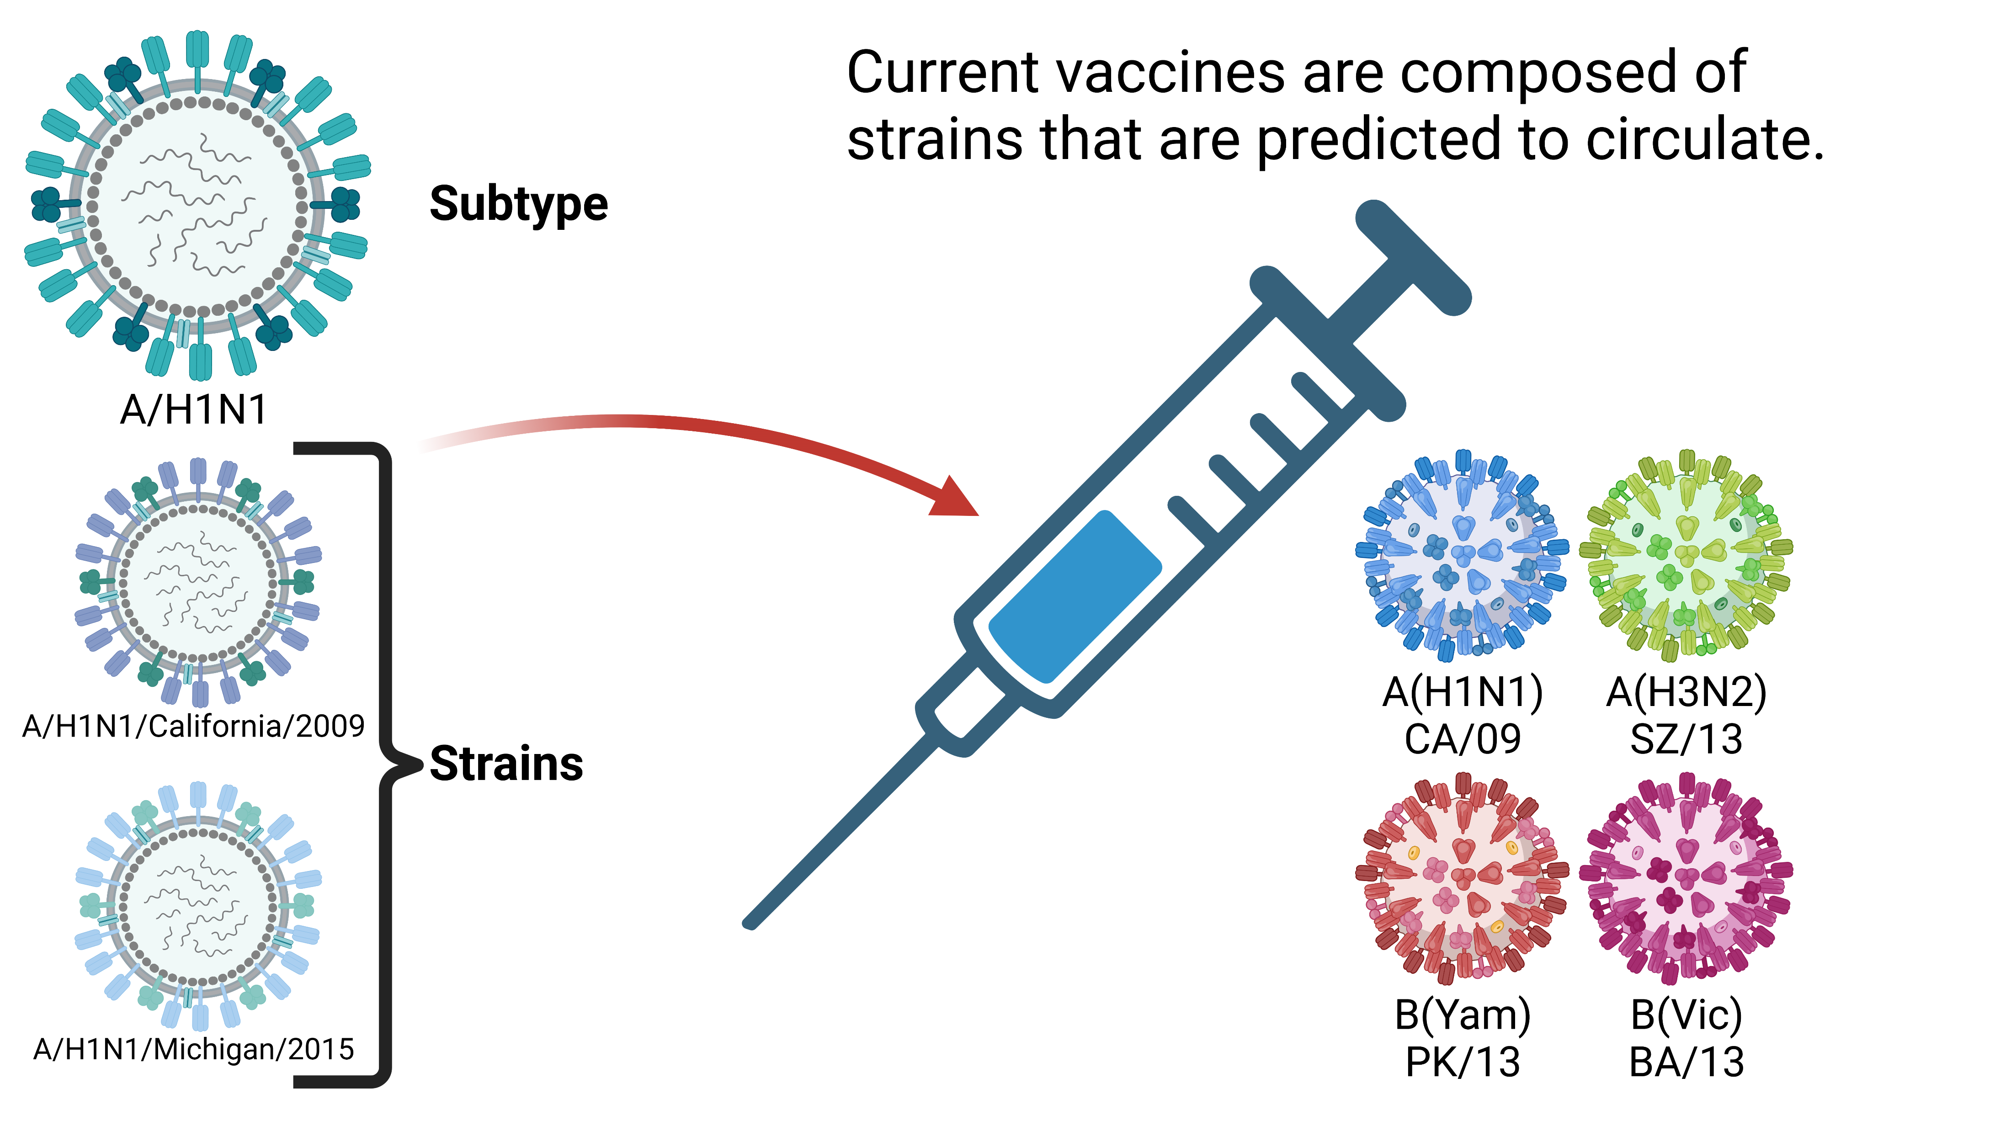
(or lineage for flu B)
Notes:
The vaccine is made of four strains, genetic variants within a subtype. Two A and two B.

Slide 8
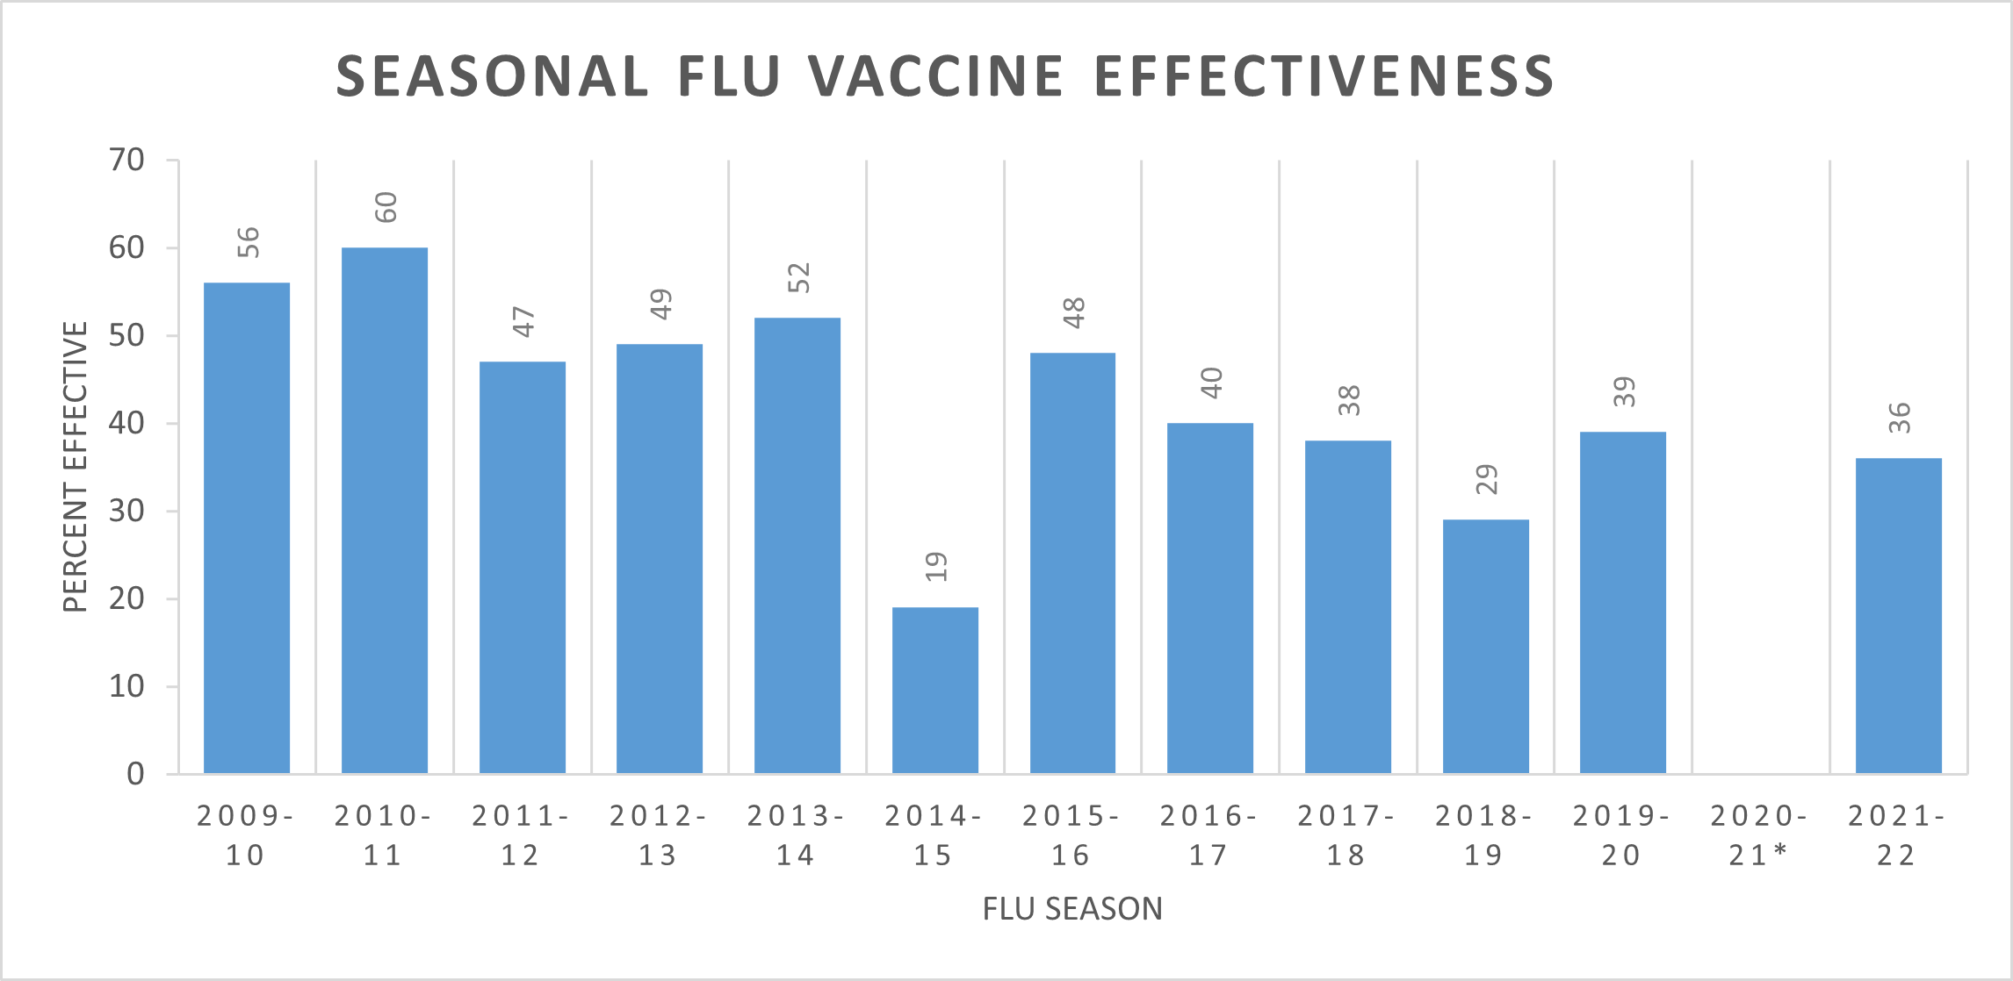
* COVID lockdown
CDC: https://www.cdc.gov/flu/vaccines-work/effectiveness-studies.htm
Notes:
These strain specific vaccines ALWAYS have low effectiveness, regardless of if the strains match or not.

Slide 9
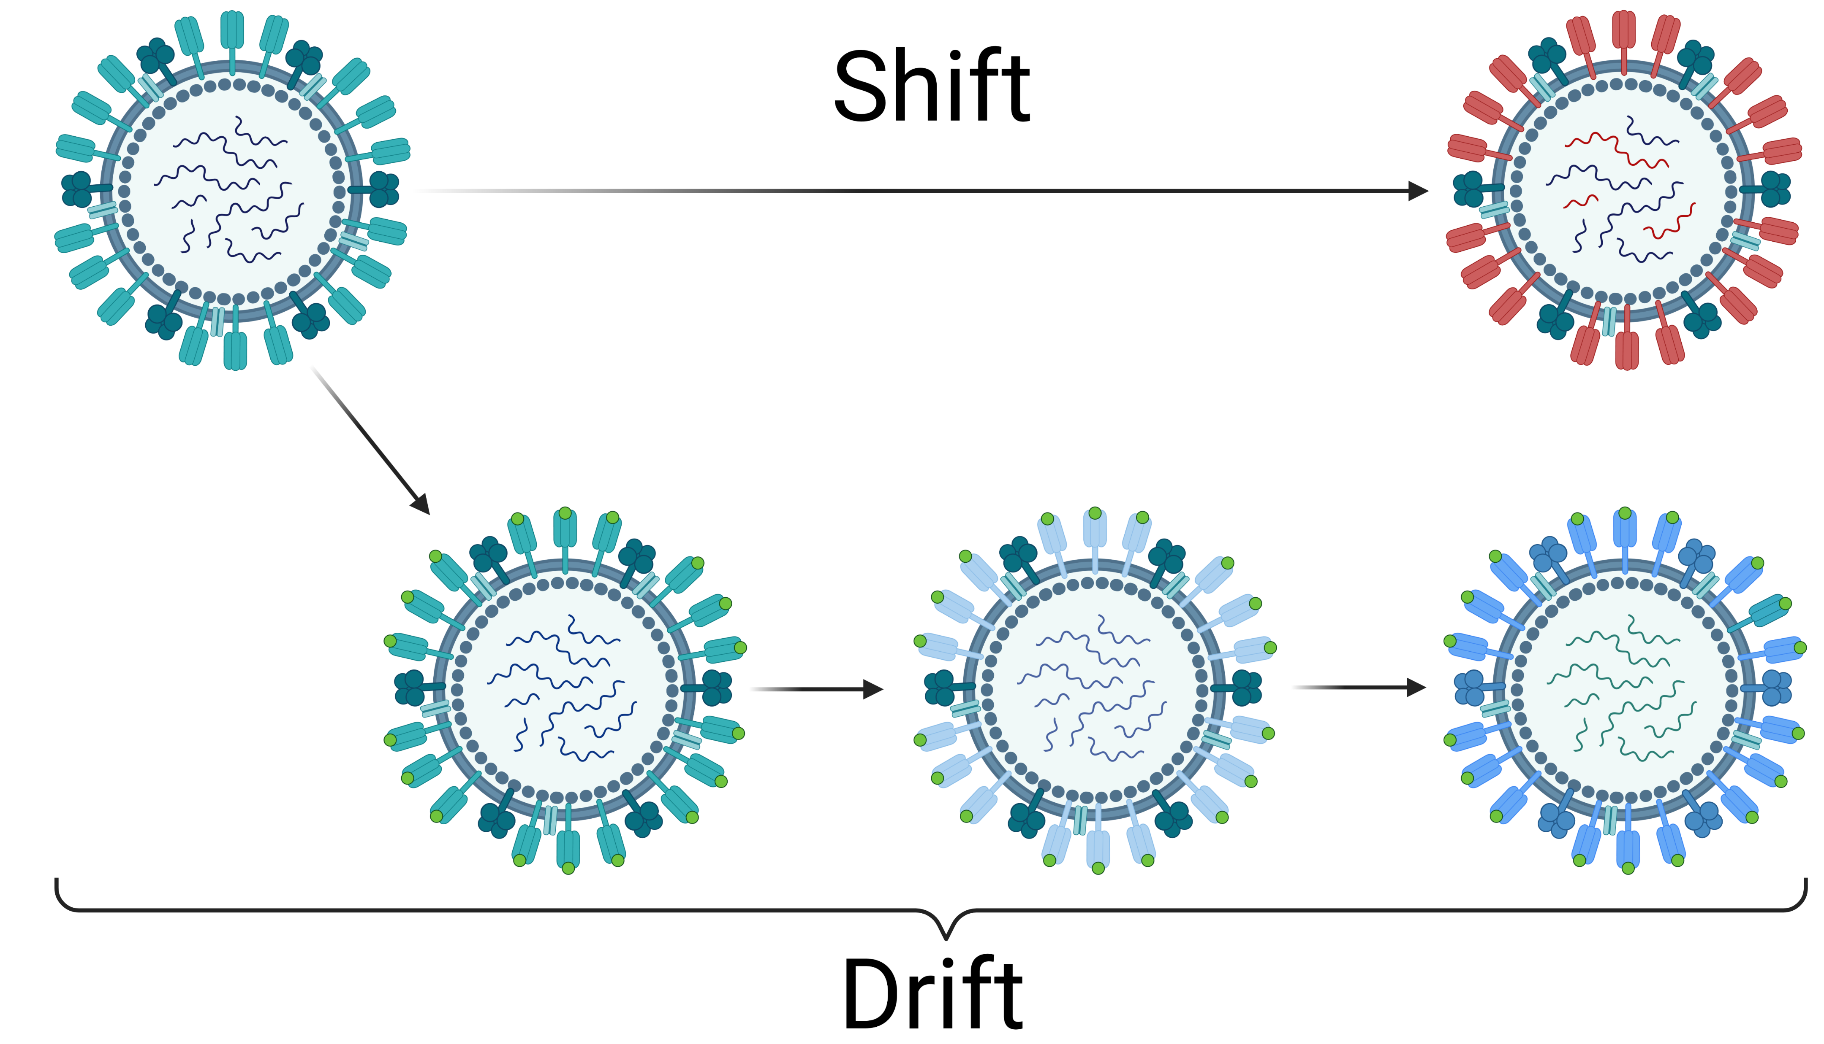
Notes:
The major challenge in influenza immunology is rapid evolution.
Influenza mutates rapidly in response to host selective pressure. Antigenic innovations occur via two main pathways
Drift: regular, expected mutations over time to maintain/increase fitness
Shift: recombination results in the creation of antigenically novel flu strains, happens suddenly

Slide 10
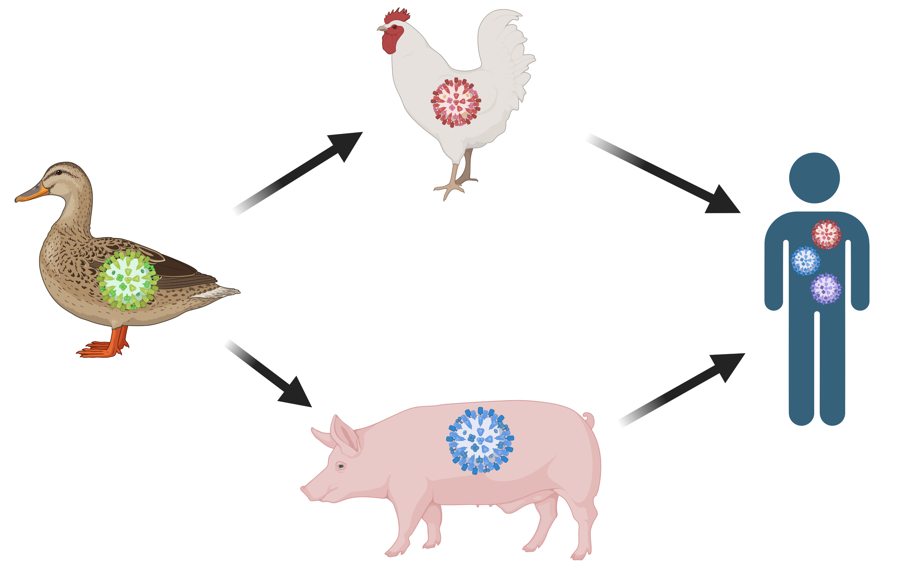
Notes:
Due to the possibility of shift, we have to deal with the additional problem of novel influenza strains spontaneously emerging at any time.
Example: March 2023 Cambodia spillover events, 2009 H1N1
The seasonal vaccine typically does not protect against these strains and in 2008 the seasonal vaccine could have made pandemic responses worse.

Slide 11
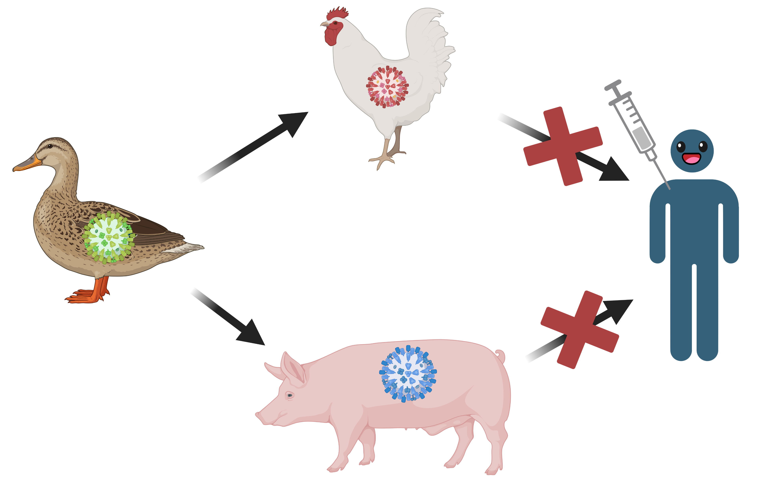
Notes:
So in addition to increasing the VE, we are motivated to develop “broadly reactive” vaccines that can protect against unseen strains.

Slide 12
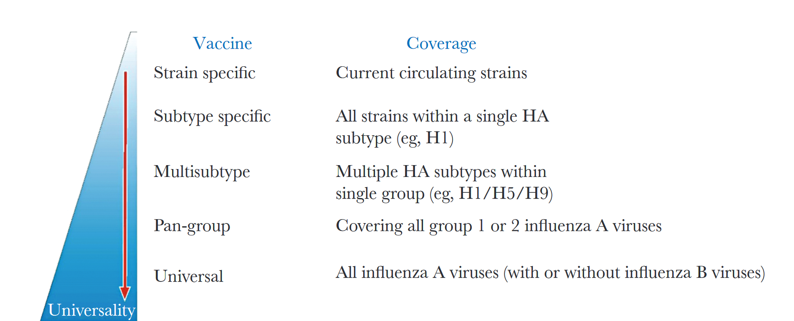
A universal vaccine could solve both problems!
Erbelding et al, JID, 2018
Notes:
The so-called universal vaccine should provide better coverage against seasonal strains, and will also mitigate pandemic events.

Slide 13
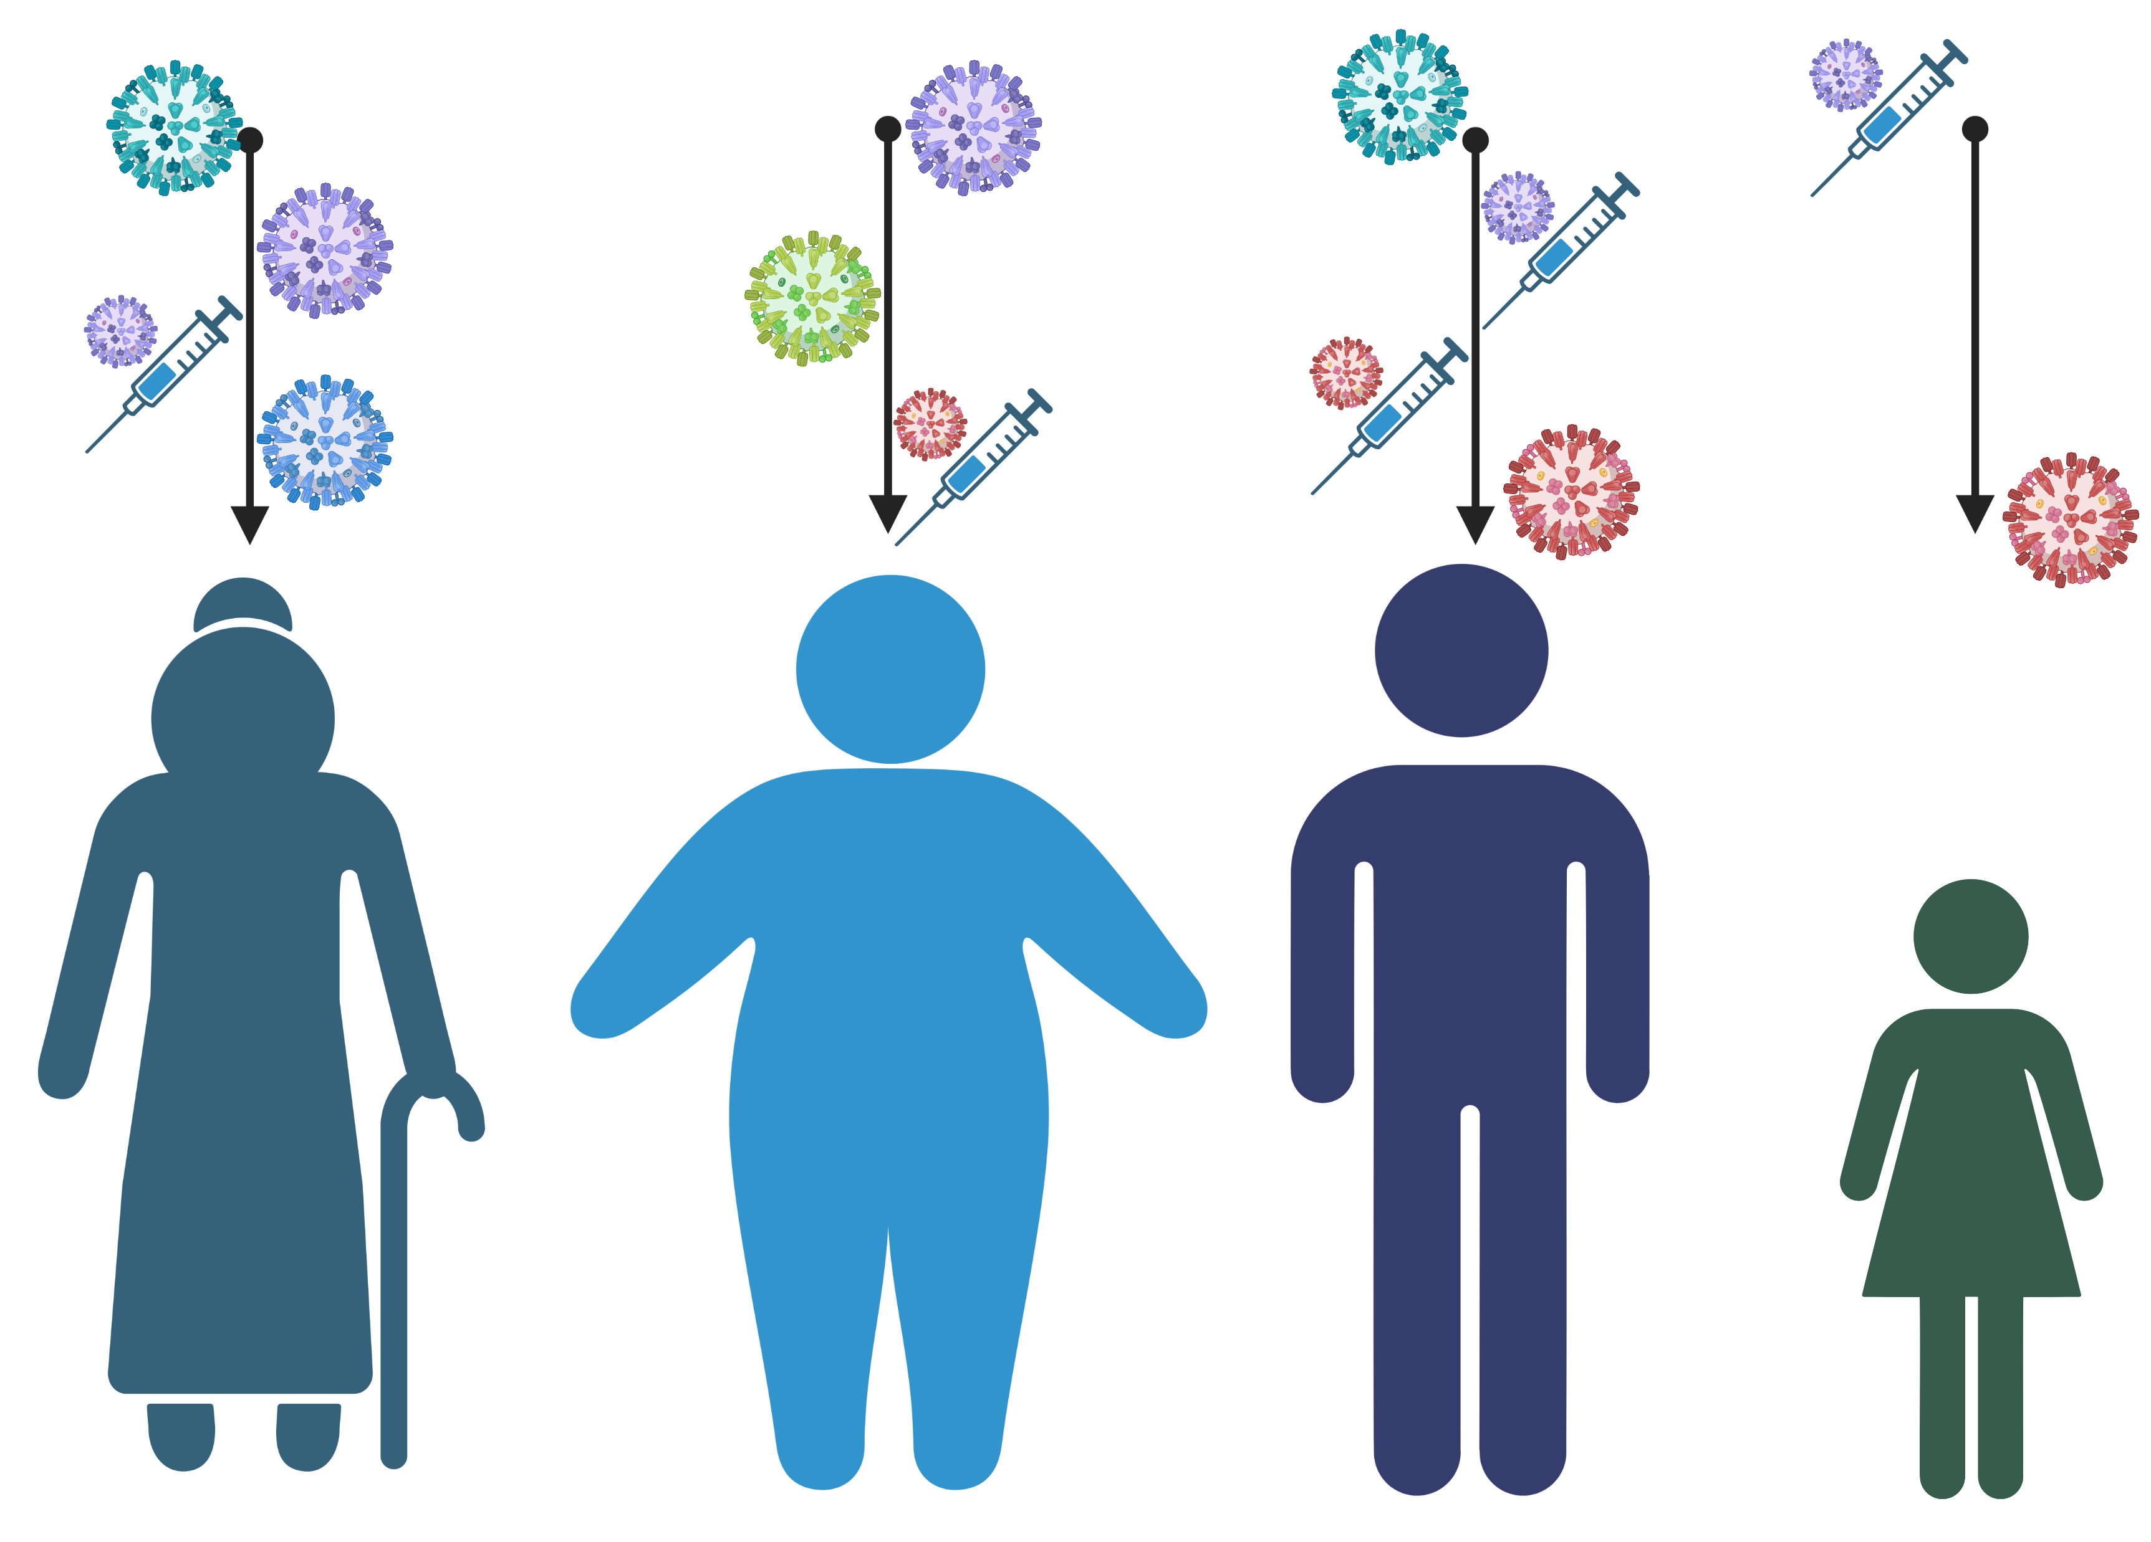
Notes:
Making a universal vaccine is hard because the population is so different.

Slide 14
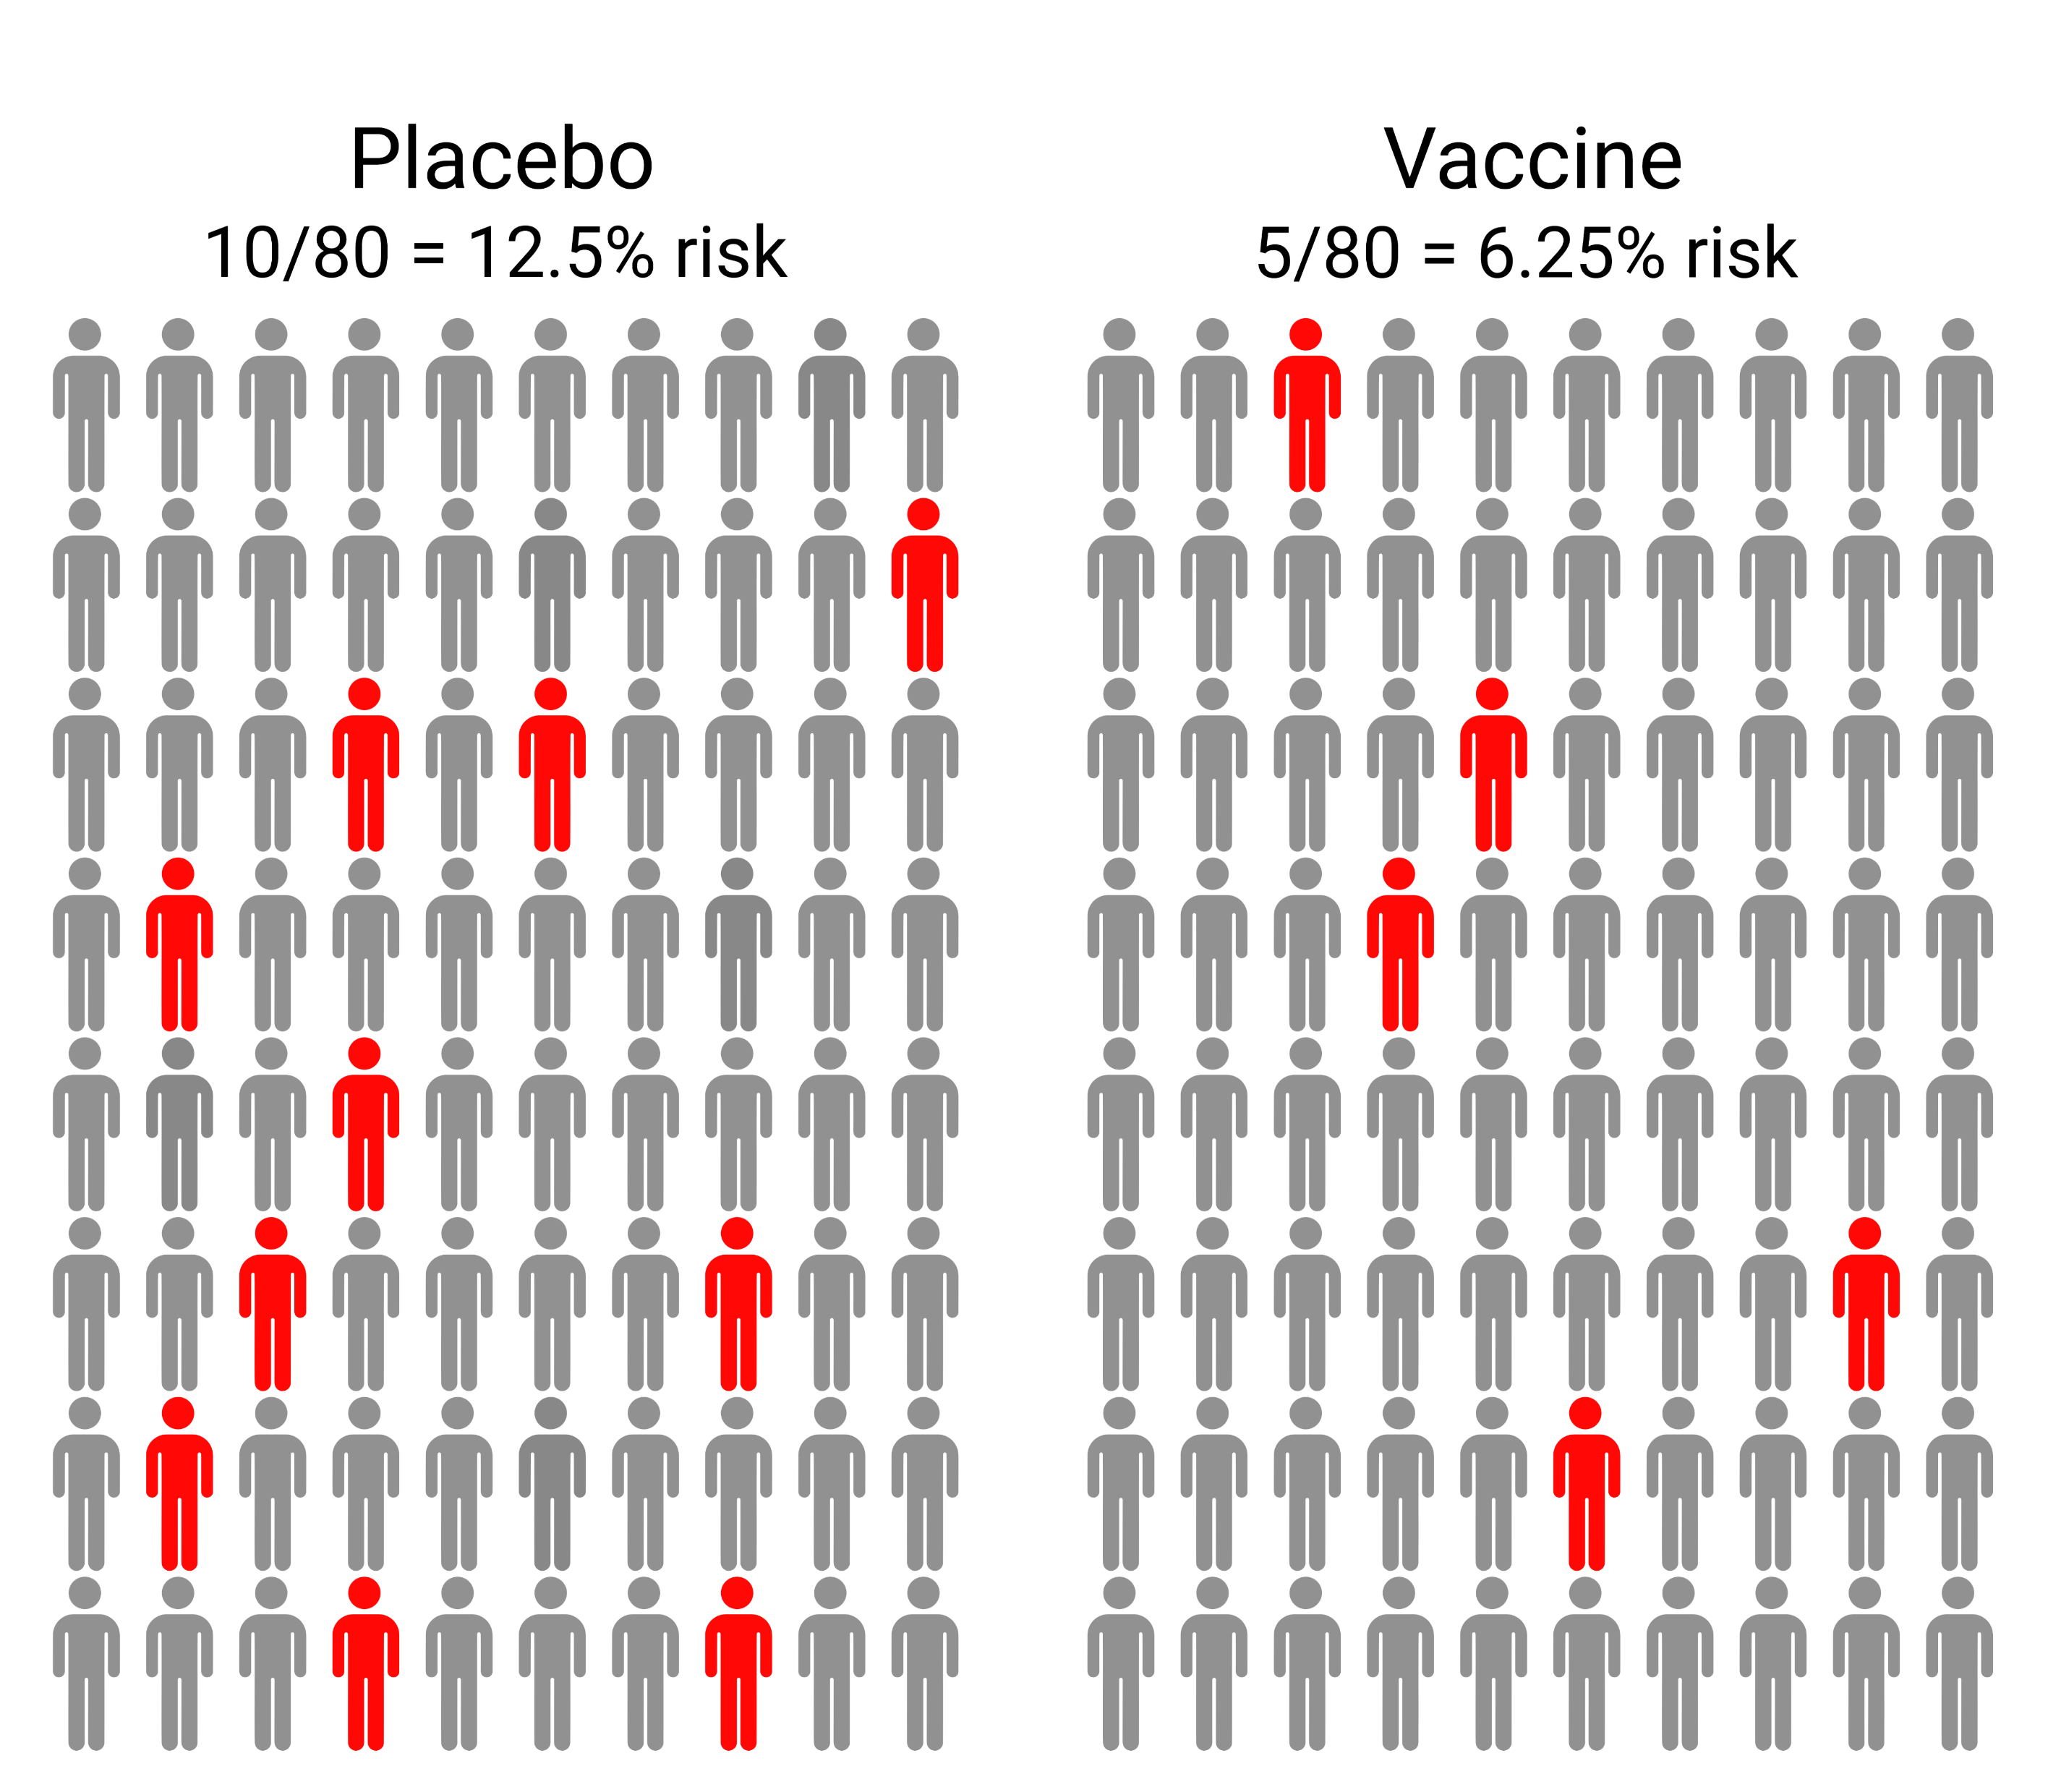
Notes:
The normal way to measure this is with a vaccine efficacy trial, which is impossible to do for a wide variety of strains that don’t circulate anymore.

Slide 15
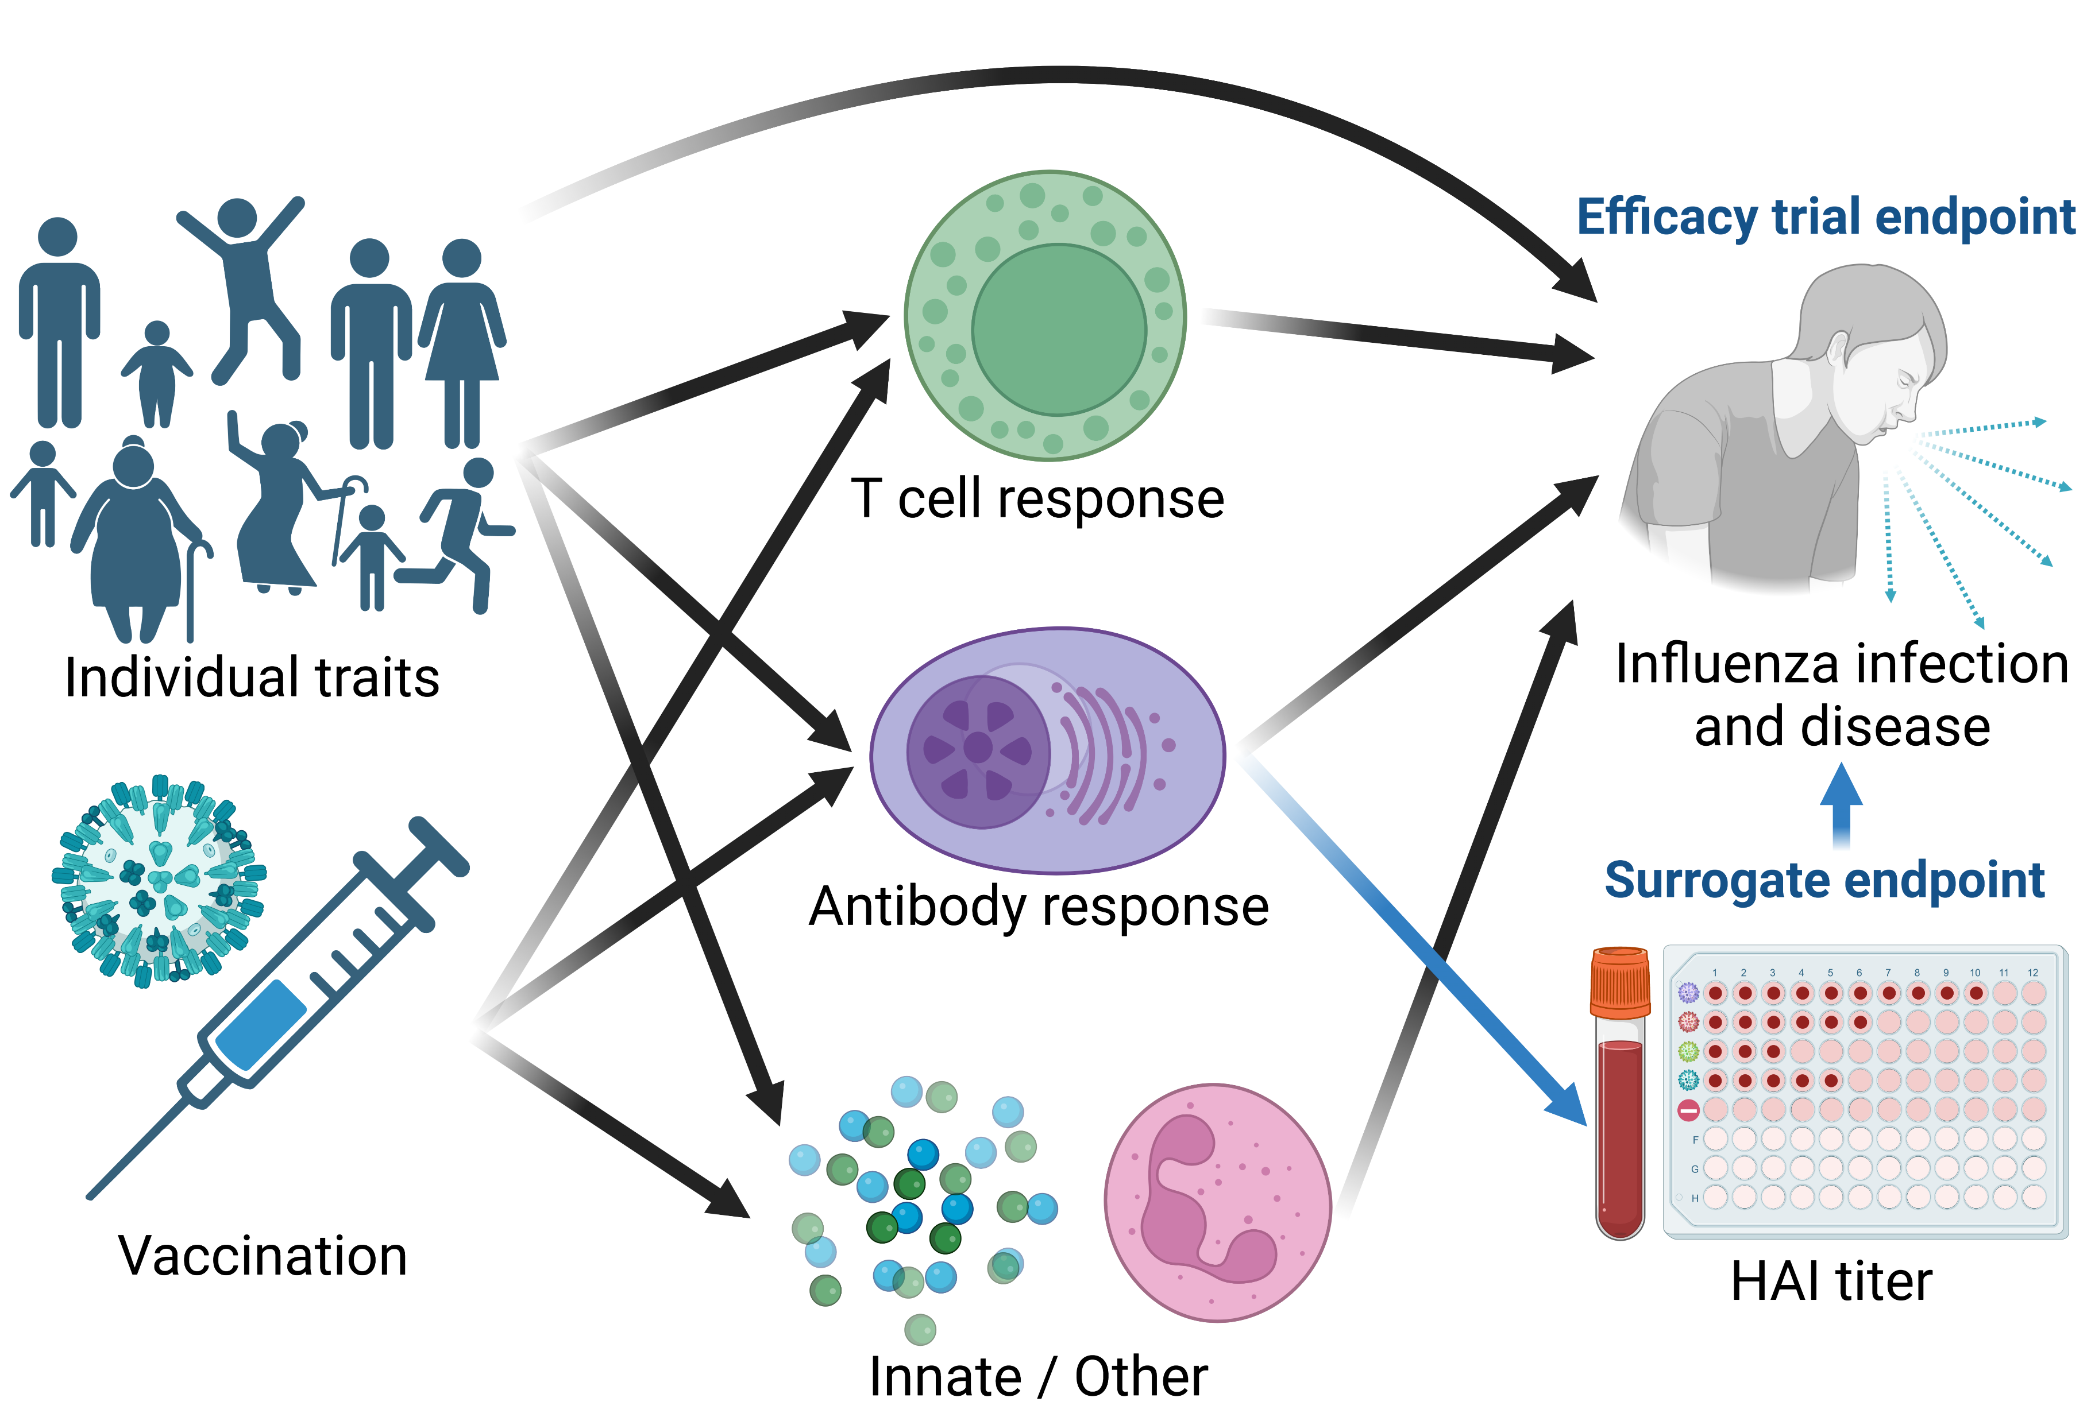
Notes:
So instead we use a surrogate endpoint, for flu it is HAI titer.

Slide 16
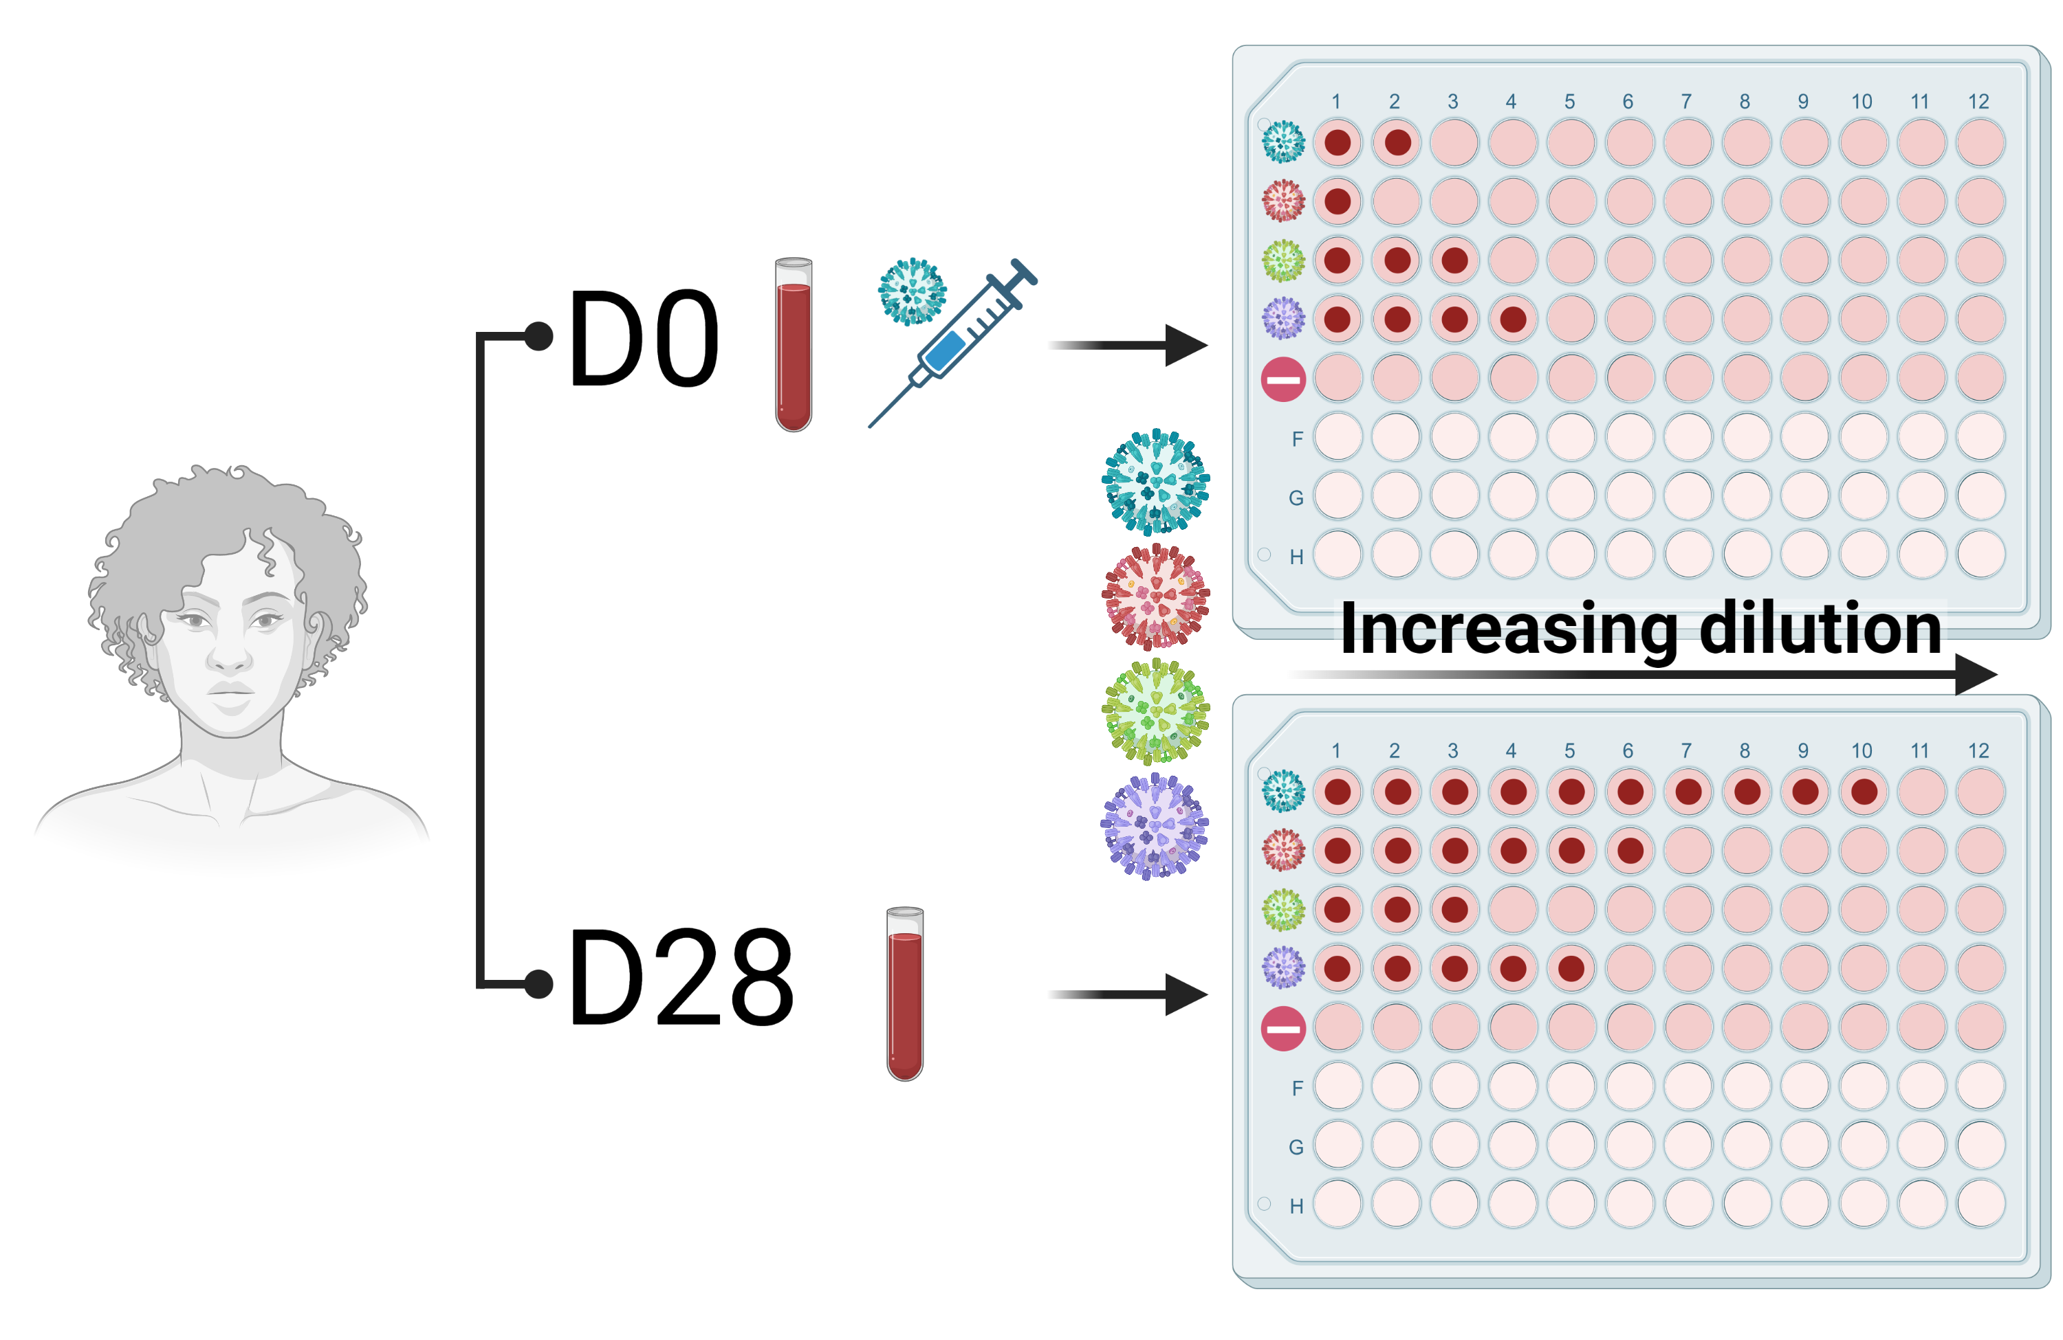
Notes:
Which we can test against a wide variety of panels and compare pre/post vaccination.

Slide 17
Homologous
Heterologous
Notes:
Which we can test against a wide variety of panels and compare pre/post vaccination.

Slide 18
How do we evaluate these vaccines?
Magnitude: the response to the homologous strain.
Breadth: responses to heterologous strains.
Overall strength: can we combine magnitude and breadth into one measurement of “goodness”?

Slide 19
Data description

Slide 20
Data description: UGAFluVac
Run by Ted Ross, currently housed at UGA
2013-2016 in Stuart, FL and Pittsburgh, PA
January 2017 – Present in Athens, GA
Prospective open cohort design with prevaccination and postvaccination serum samples tested against a wide homologous panel
Participants received either Fluzone or Fluzone HD (if ≥65)

Slide 21
Data description: RocFluVac
Run by Andrea Sant and Angela Branche, currently at the University of Rochester
Longitudinal data from 2015 – 2019
HAI measurements to select strains pre- and post-vaccination, plus additional assays (ELISA, FRNT, T cells)
Participants (18-49) received Fluzone, Fluzone HD, Flucelvax, or Flublok

Slide 22
Aims

Slide 23
Specific aims
Develop metrics for the quantification of the total immune response to an influenza vaccine, incorporating both magnitude and breadth.
Quantify the role of pre-vaccination titer, prior vaccinations, vaccine dose, and antigenic distance on individual vaccine response.
Explore how age and vaccine dose interact to affect the antibody response.

Slide 24
Aim 1: Develop metrics for the quantification of the total immune response to an influenza vaccine, incorporating both strength and breadth.

Slide 25
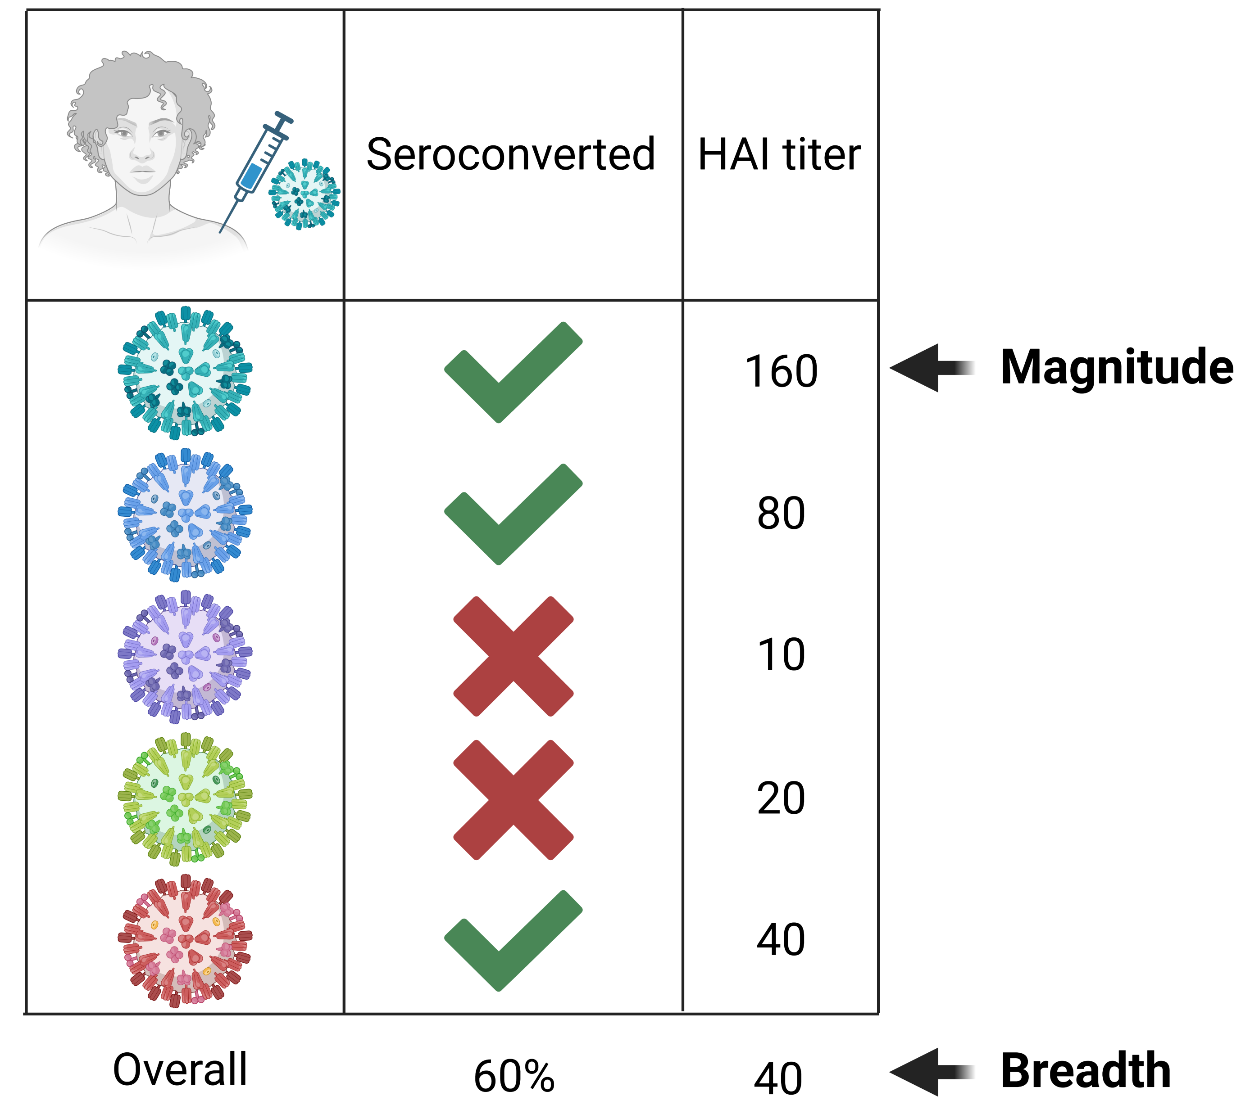

Slide 26
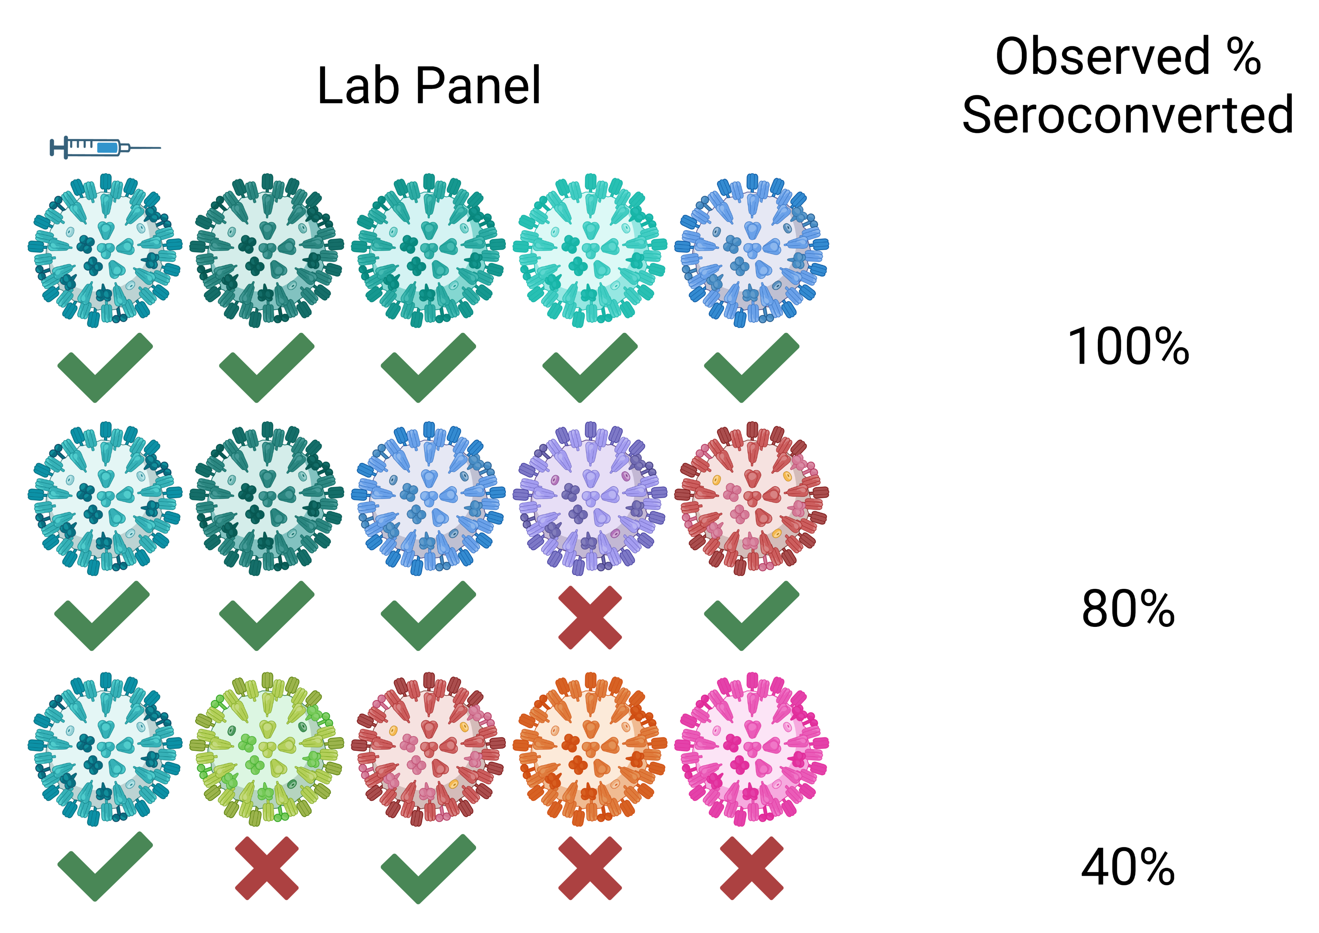

Slide 27
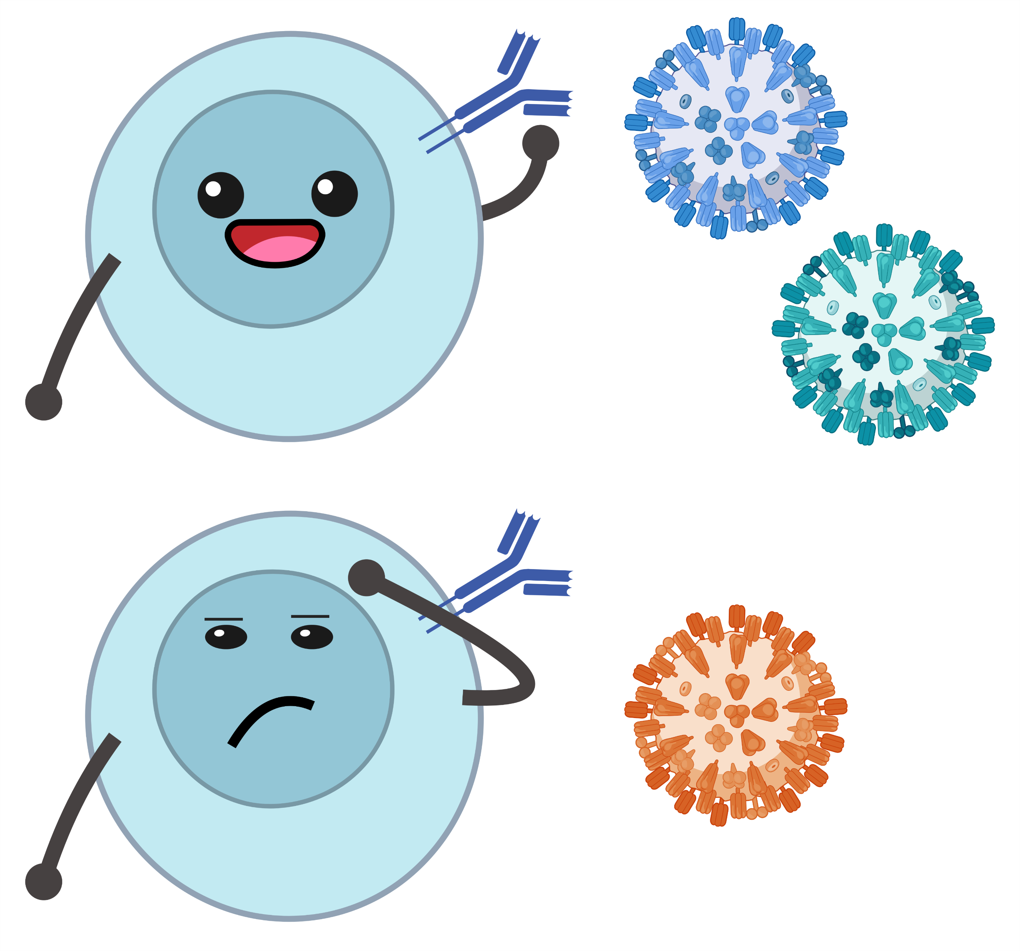
Antigenic distance: how different are two strains?
Recognition
Temporal method: based on years of strain isolation
Sequence method: based on genetic or amino acid sequence differences
Antigenic method: based on observed immune responses
No recognition

Slide 28
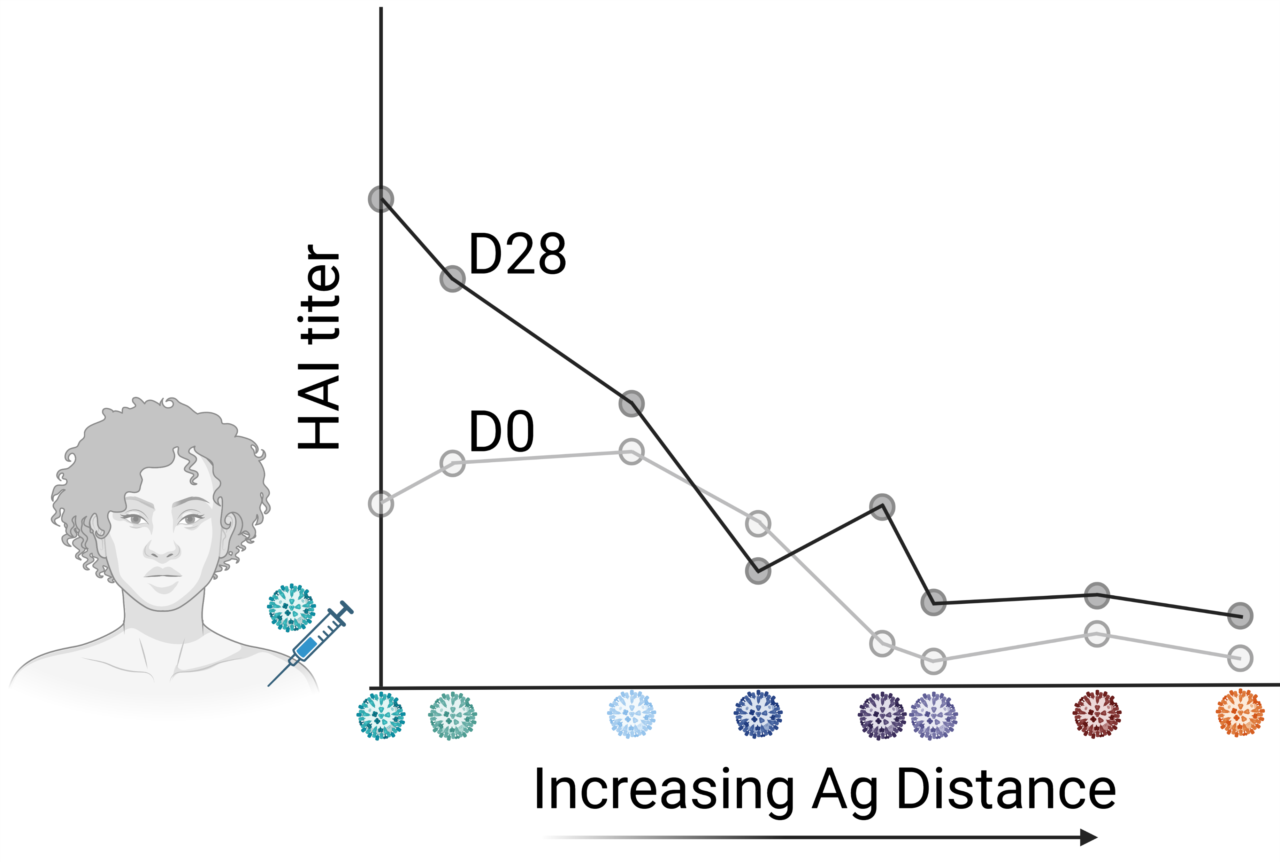

Slide 29
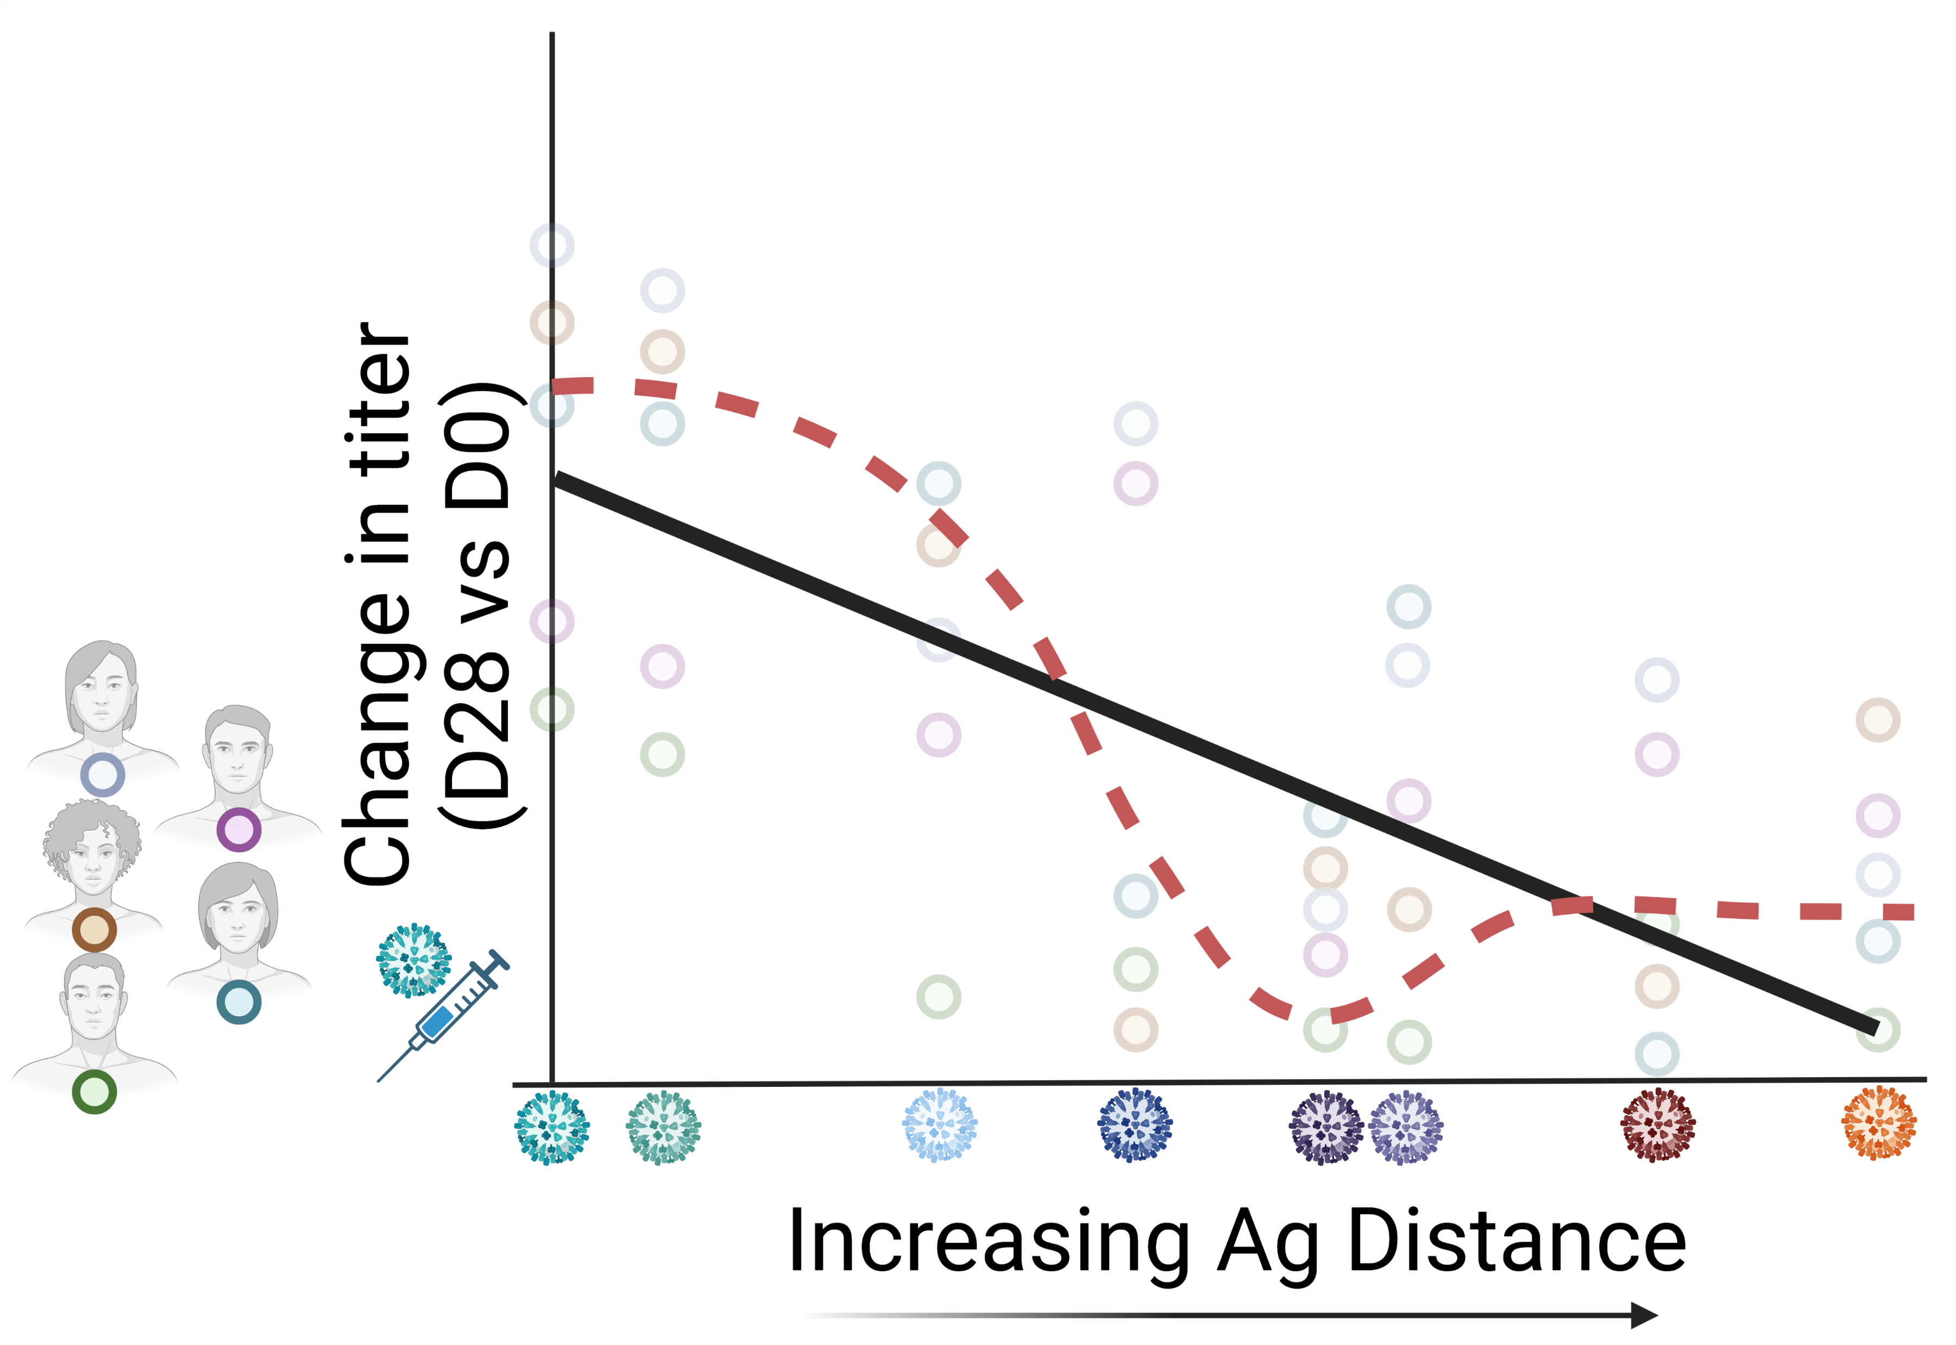

Slide 30
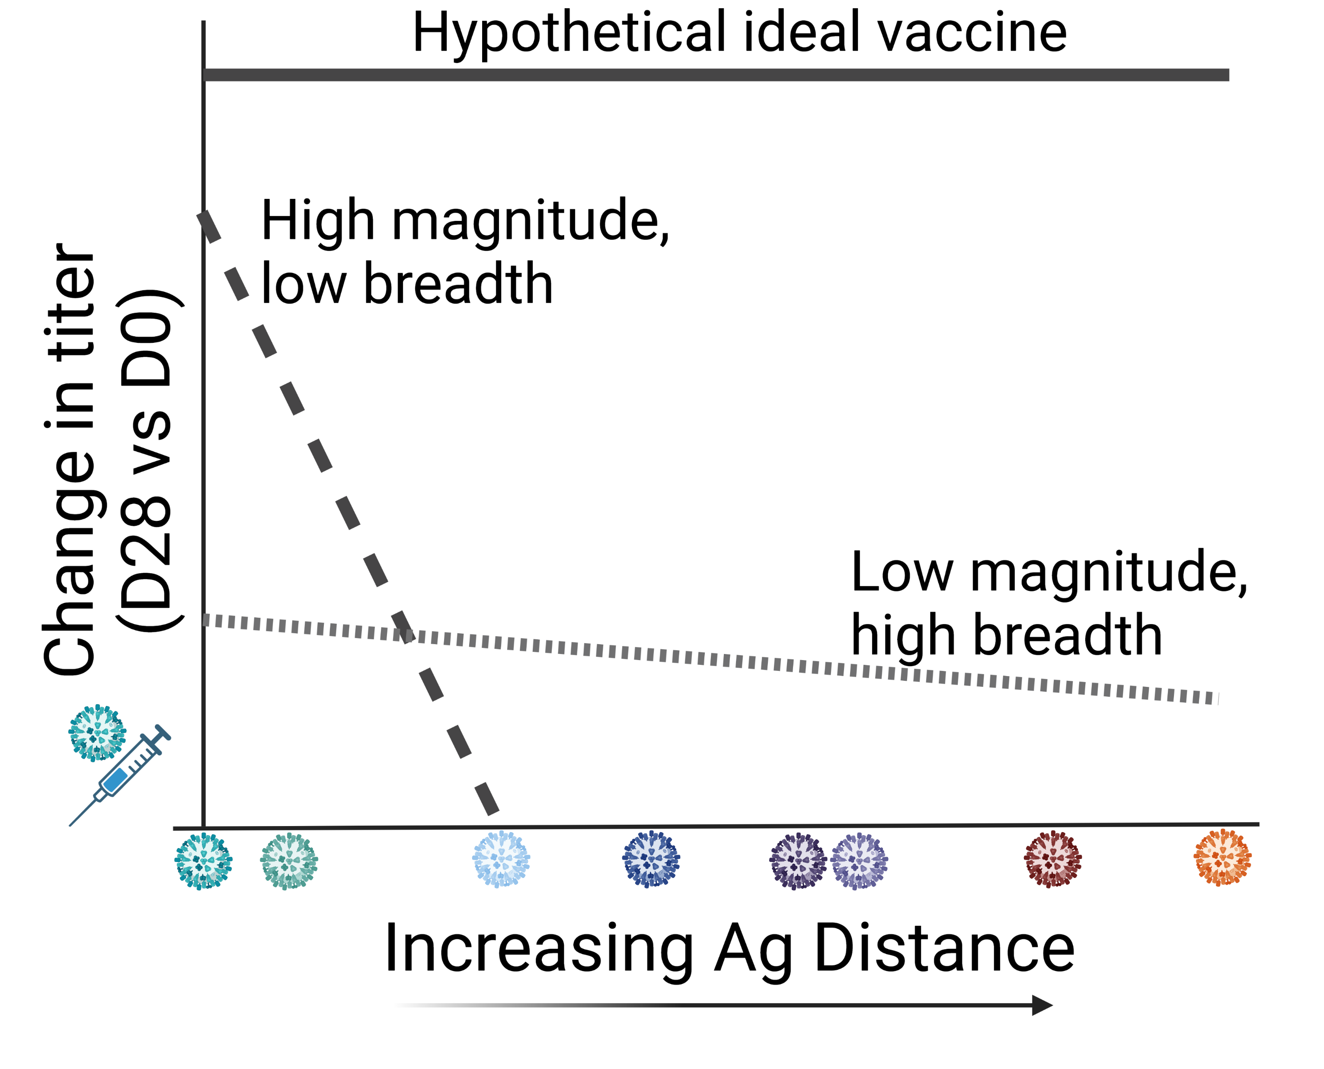

Slide 31
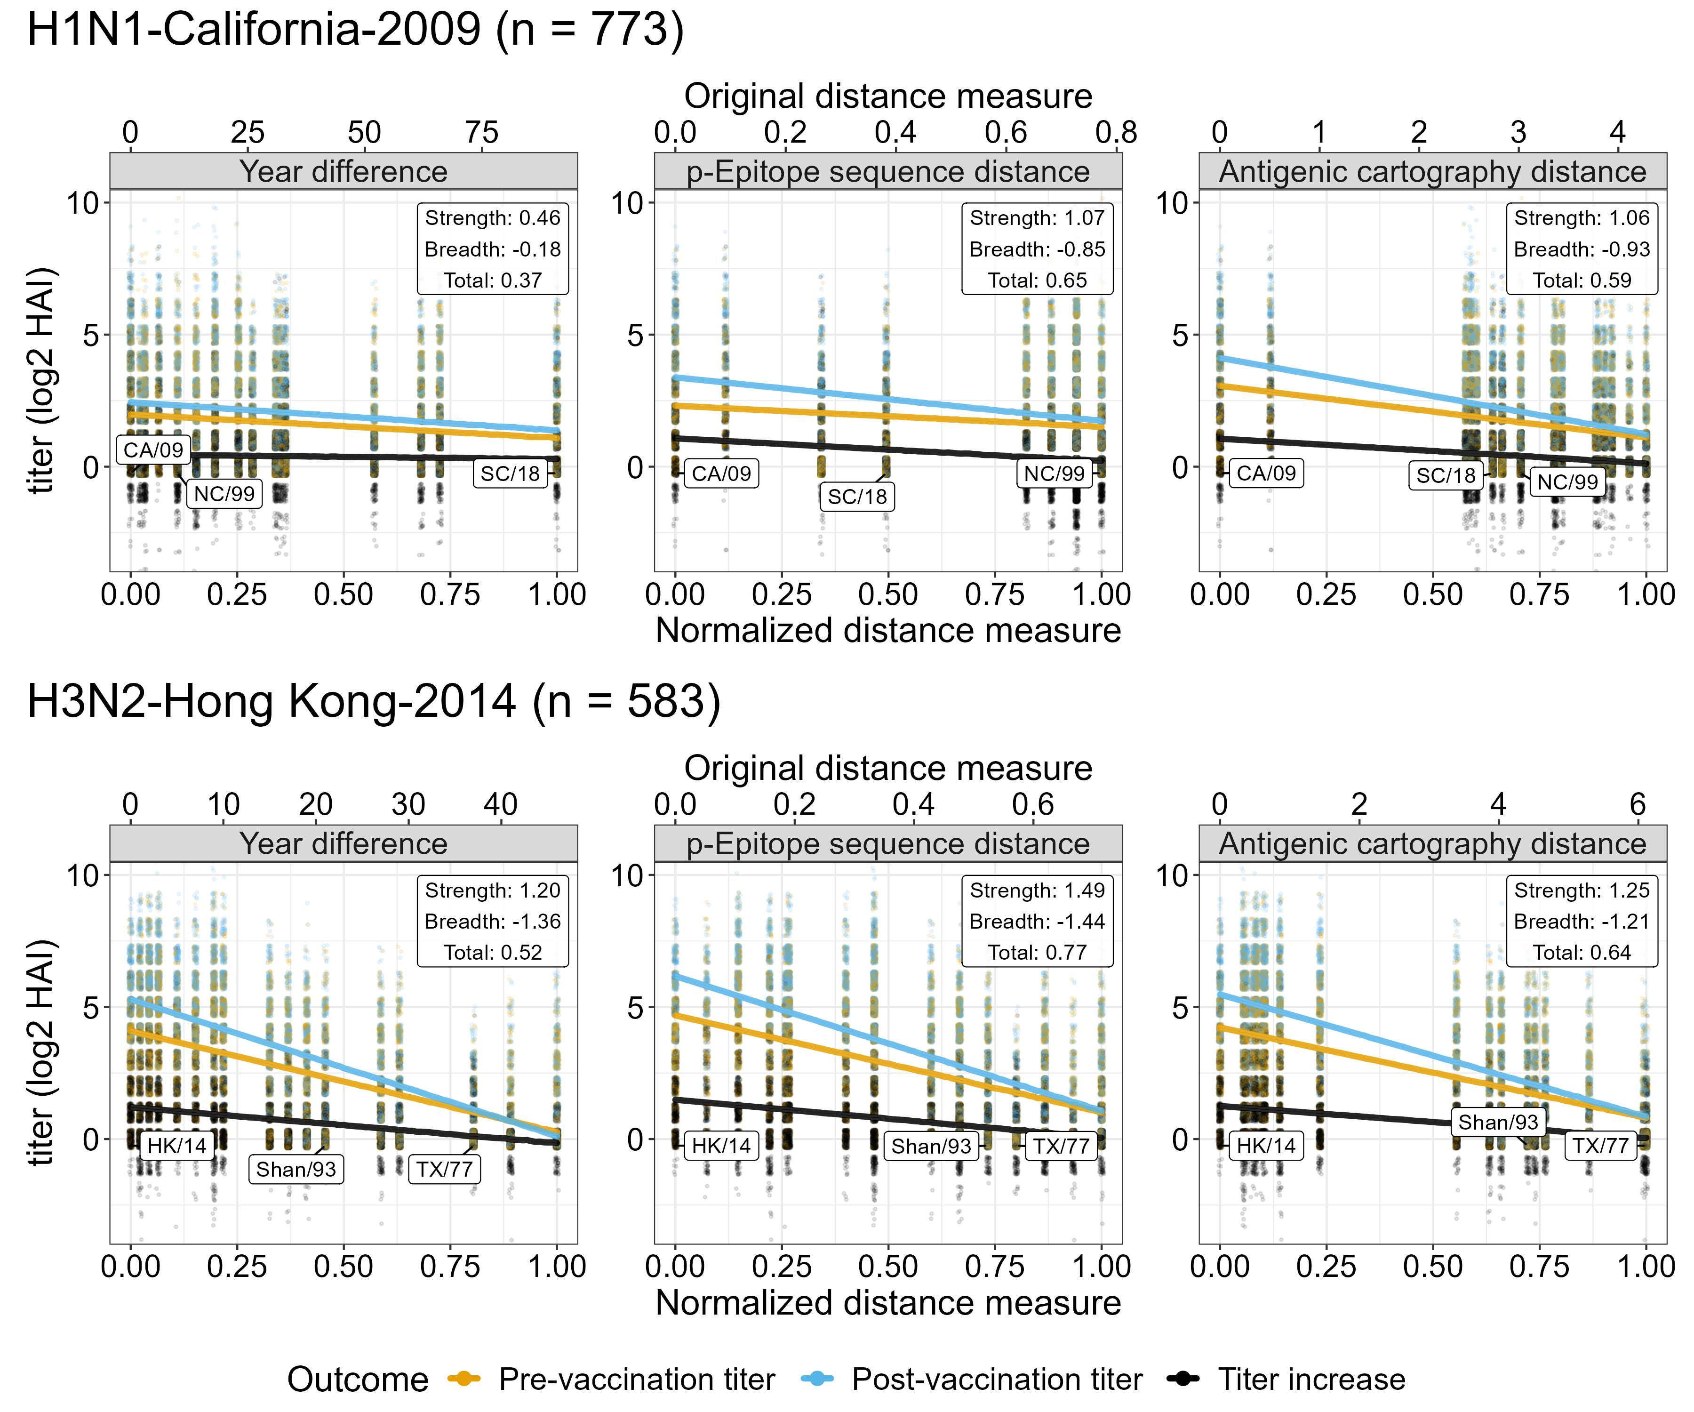

Slide 32
Proposed study
Finalize linear regression models
Compare linear and nonlinear statistical models.
Explore potential weighting schemes for the overall response and how these interact with the distance measurement used.
As a case study, compare Fluzone SD and HD.
Compare variance of metrics by subsampling panels: take k of our measured strains at a time, and compute the metrics on this subsample. Repeat that a bunch of times.

Slide 33
Aim 2: Quantify the role of pre-vaccination titer, prior vaccinations, vaccine dose, and antigenic distance on individual vaccine response.

Slide 34
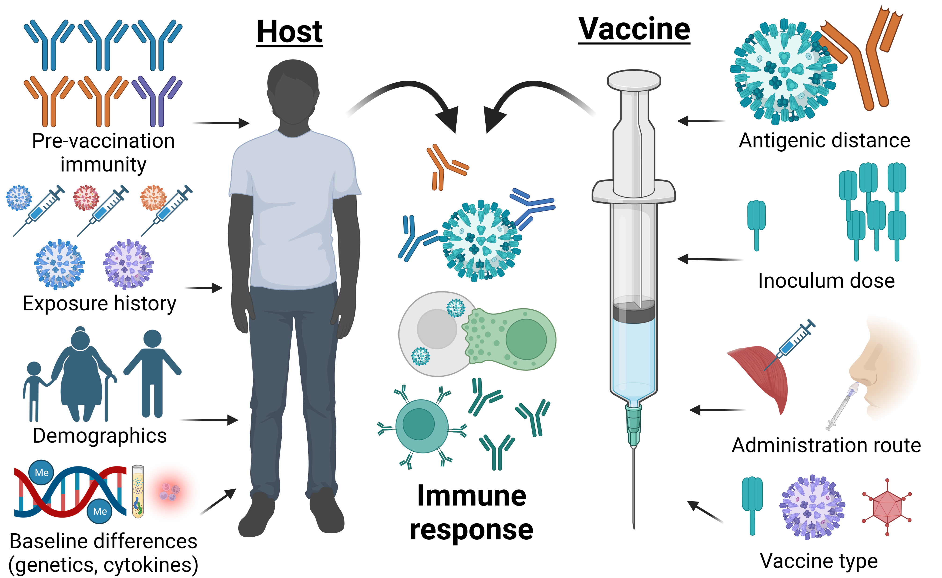

Slide 35
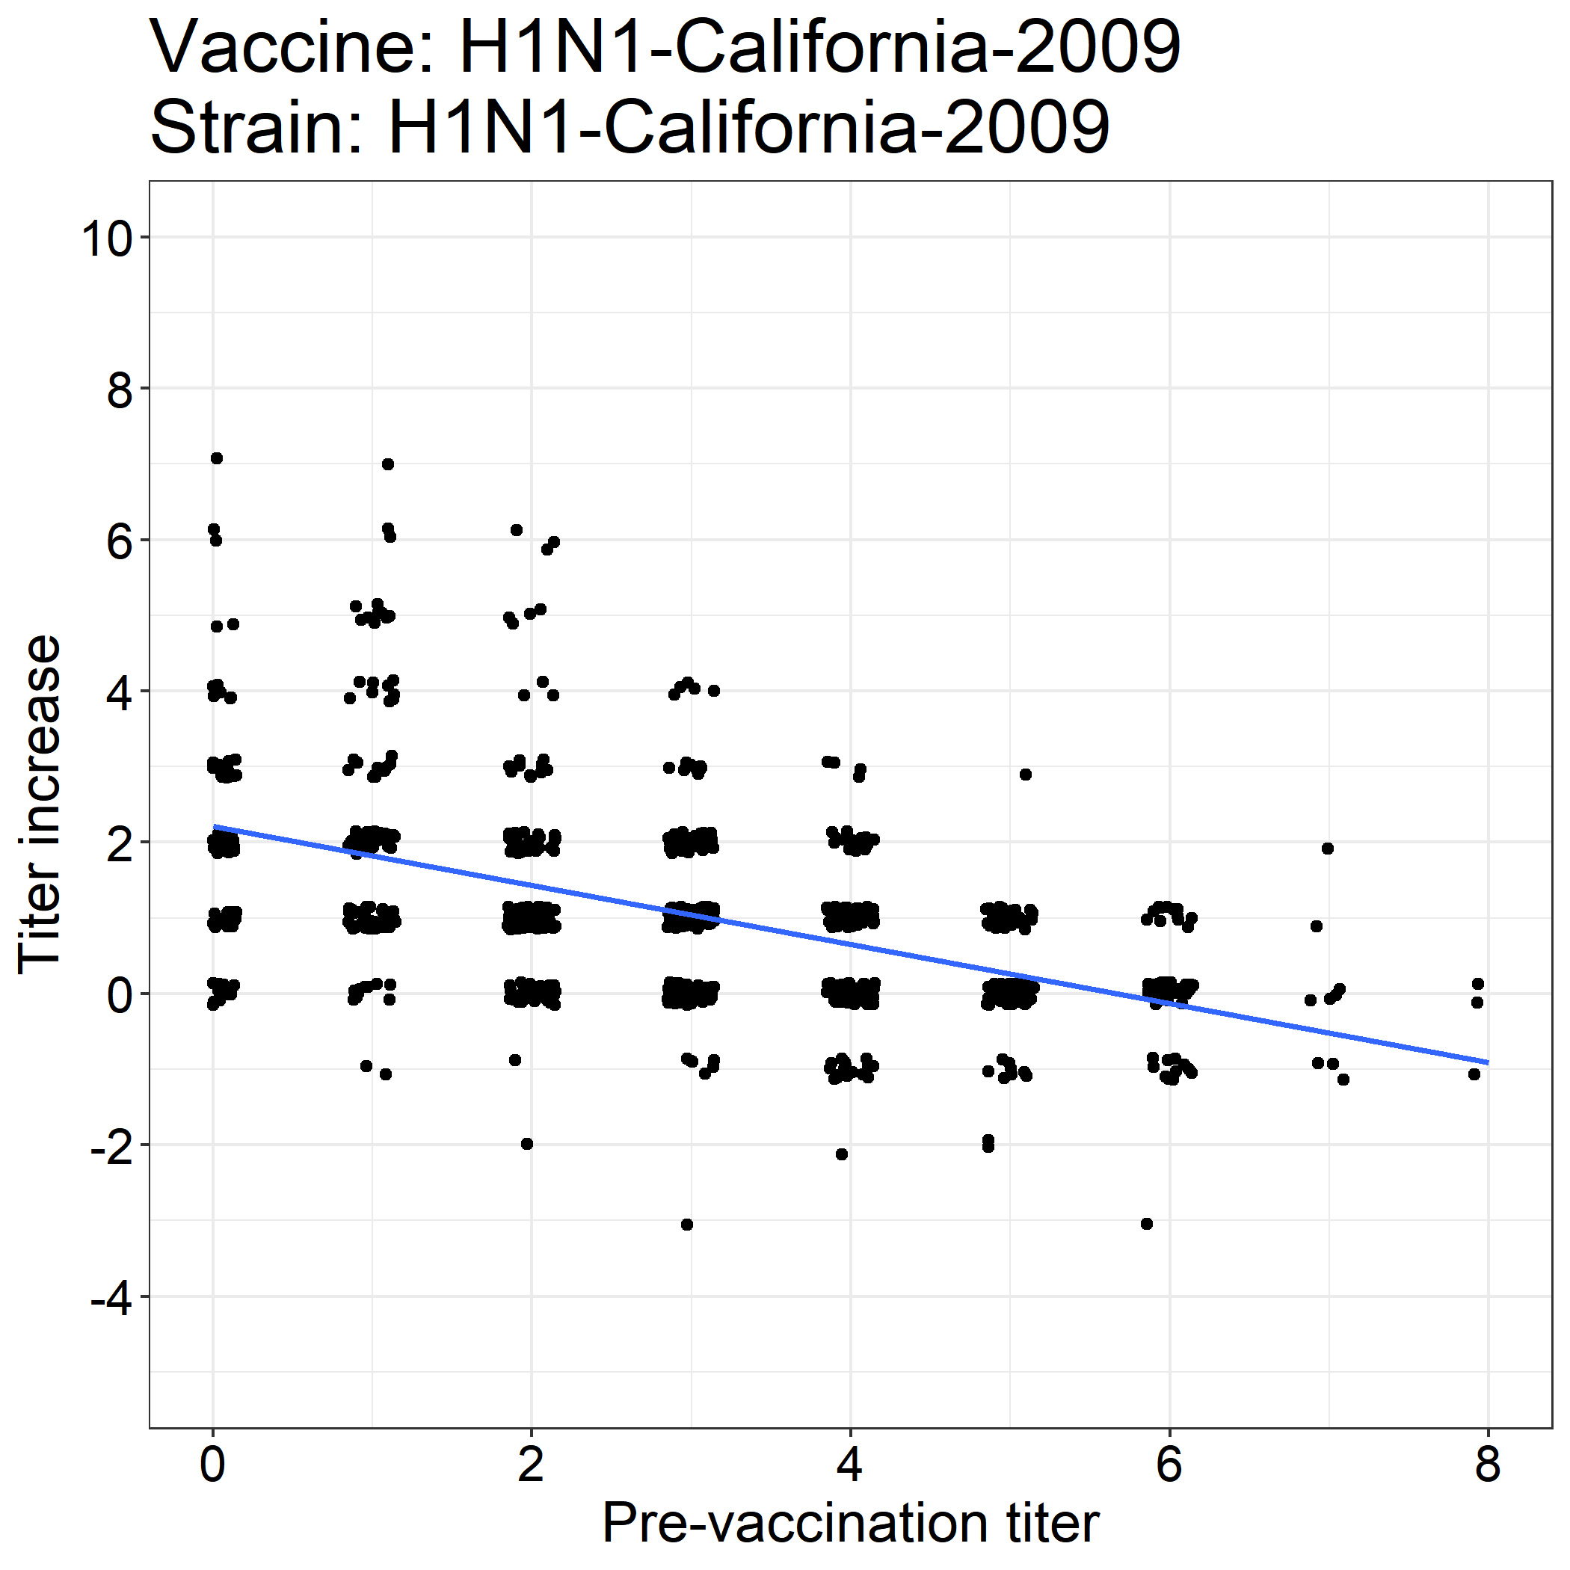
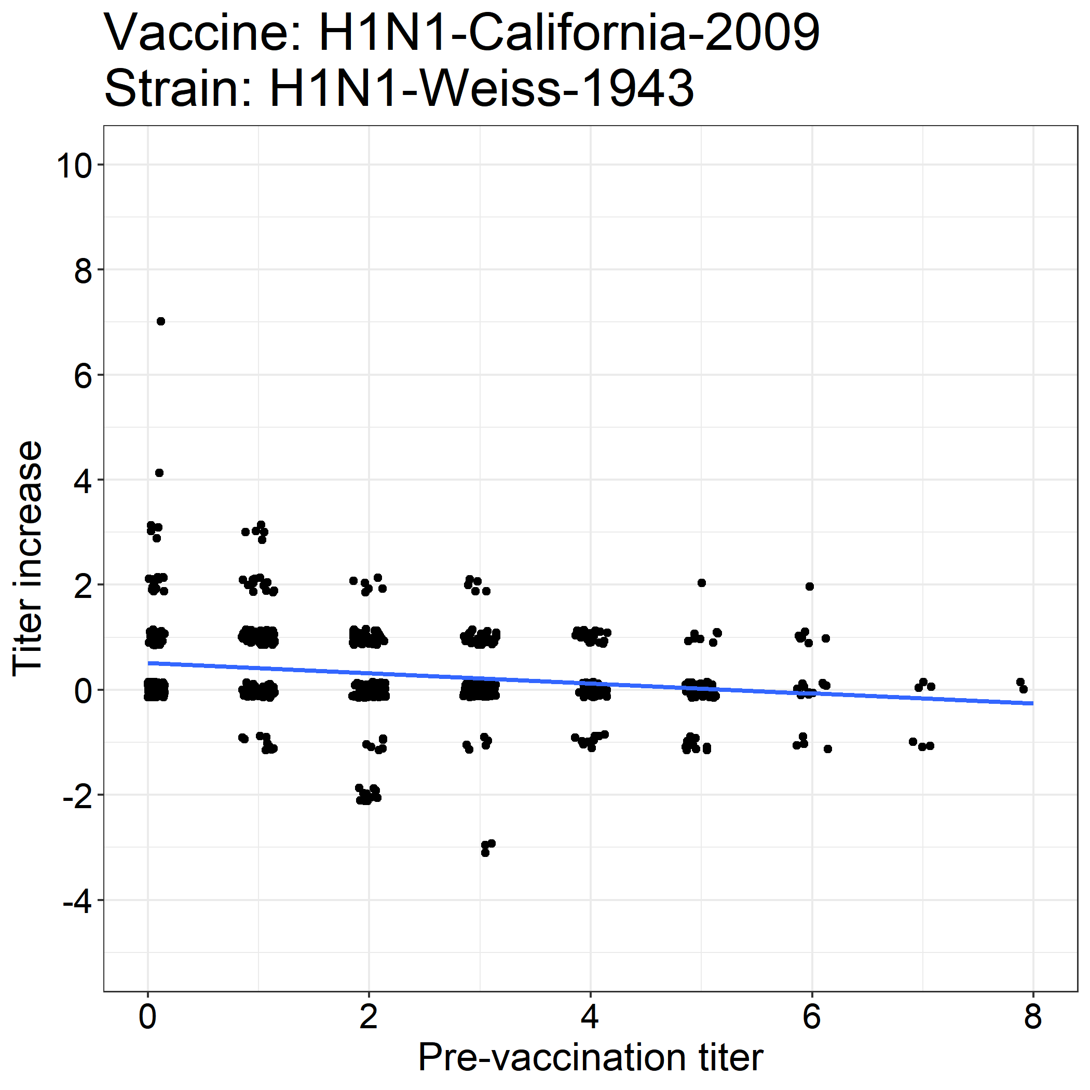

Slide 36
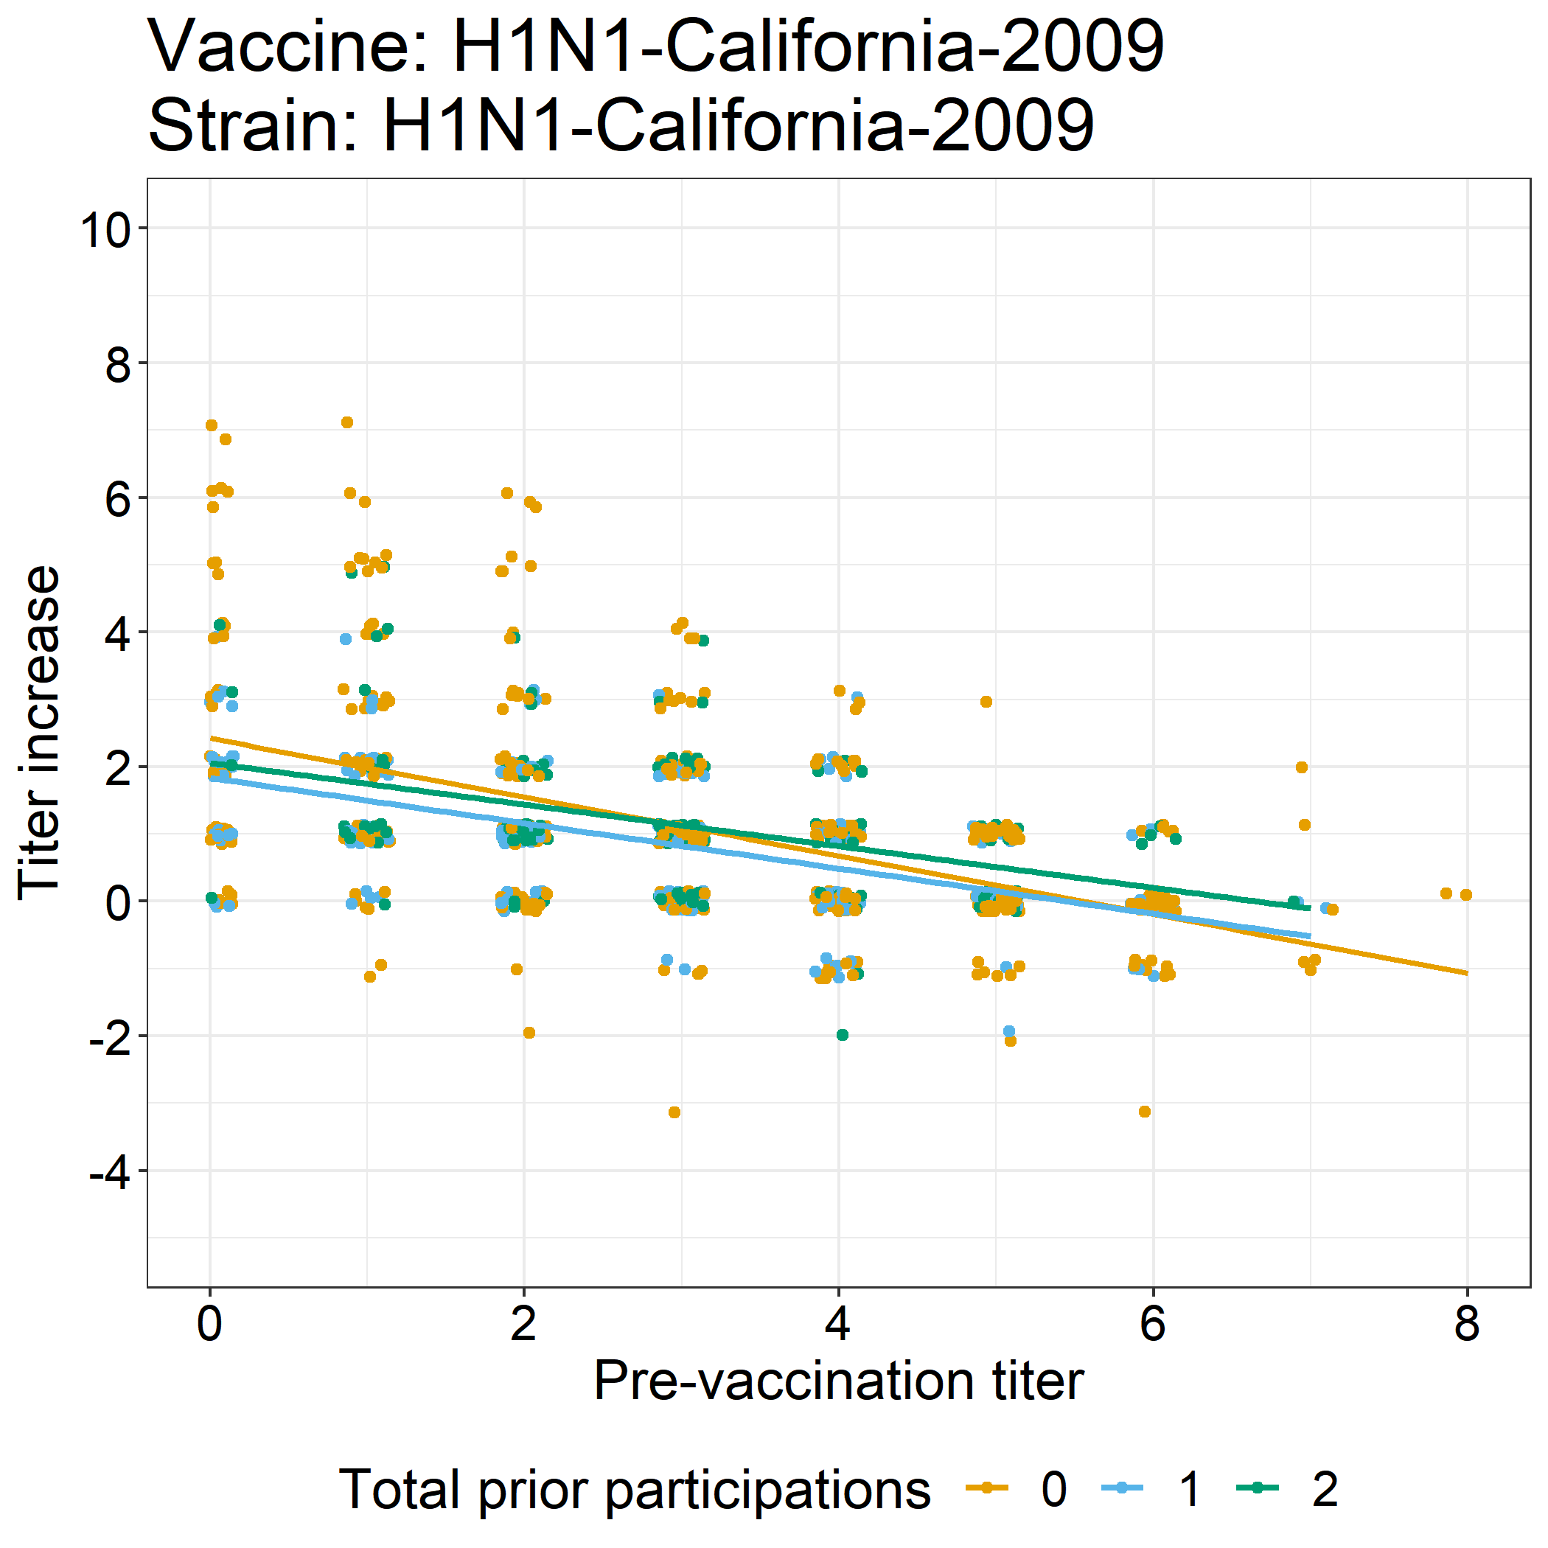
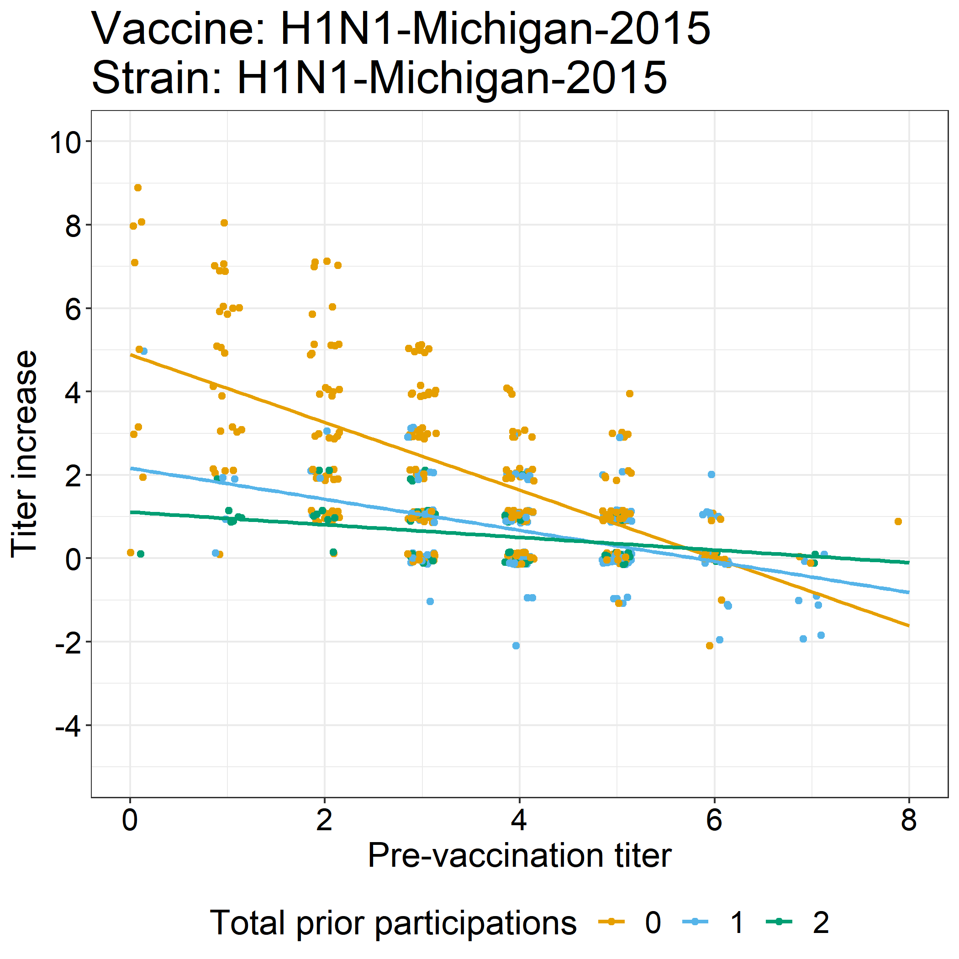

Slide 37
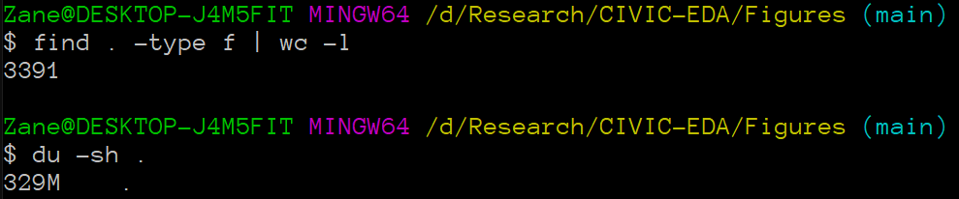
Thousands more exploratory plots (data not shown)

Slide 38
Proposed study
We will first consider models for homologous responses only, and then we will expand our analysis to consider Ag distance.
We can compare models with Ag distance to strain-specific models (including strain as a nominal variable).
Modeling approaches:
Graphical causal modeling with DAG analysis (causal approach)
Bayesian hierarchical linear models (inferential approach)
Machine learning models like random forest (predictive approach)
Ordinary differential equation models (mechanistic approach)

Slide 39
Aim 3: Explore how age and vaccine dose interact to affect the antibody response.

Slide 40
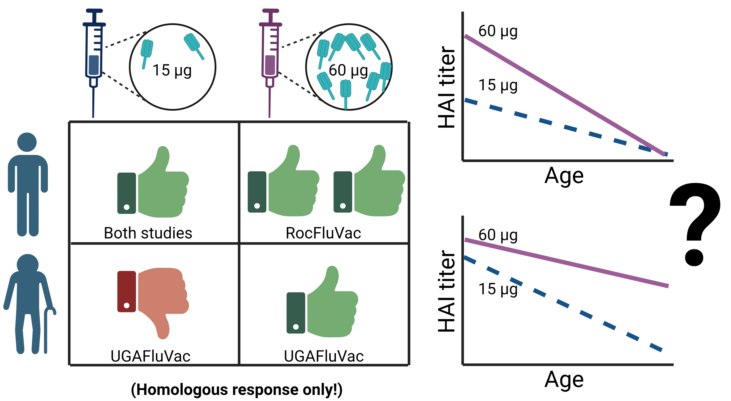

Slide 41
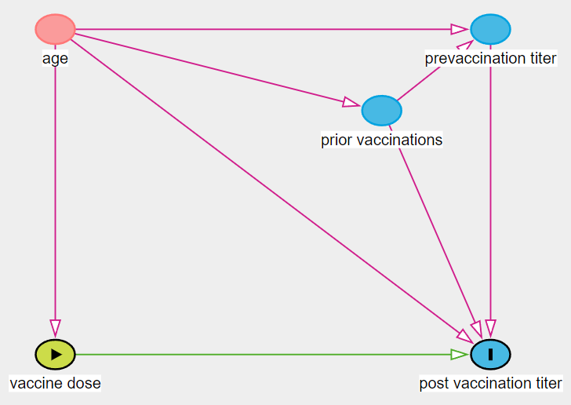
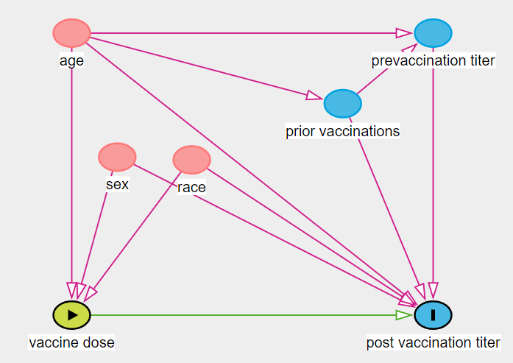
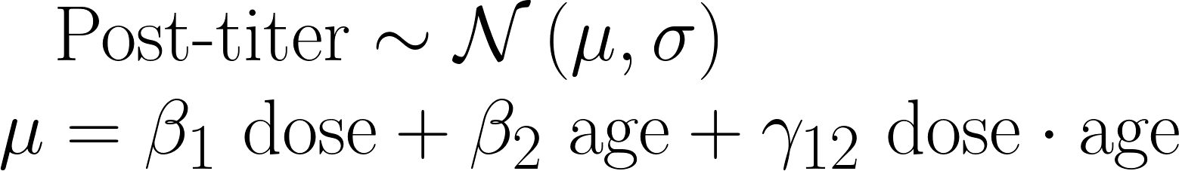
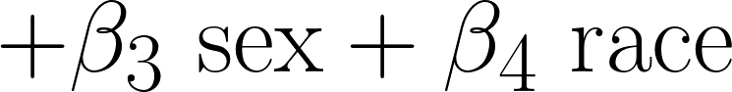

Slide 42
Proposed study
Combine UGAFluVac data (HD in 65+) with RocFluVac data provided by Andrea Sant (HD in 18 – 49).
DAG analysis
What do we adjust for to get an unbiased treatment effect?
Do our observed correlations match the implied correlations?
What other DAGs could show the same pattern?
Causal estimation
Regression with robust SEs; analysis of unmeasured confounding
Targeted maximum likelihood estimation (TMLE) approach
Estimates on both subsets, as well as overall data

Slide 43
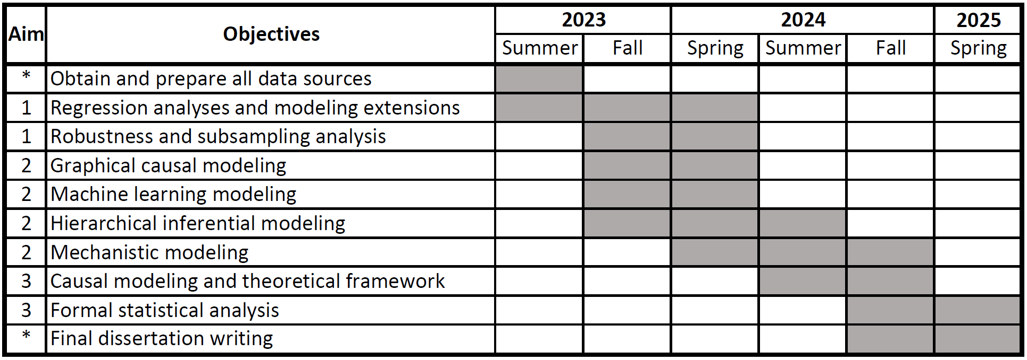
Timeline

Slide 44
Thank you!

Slide 45
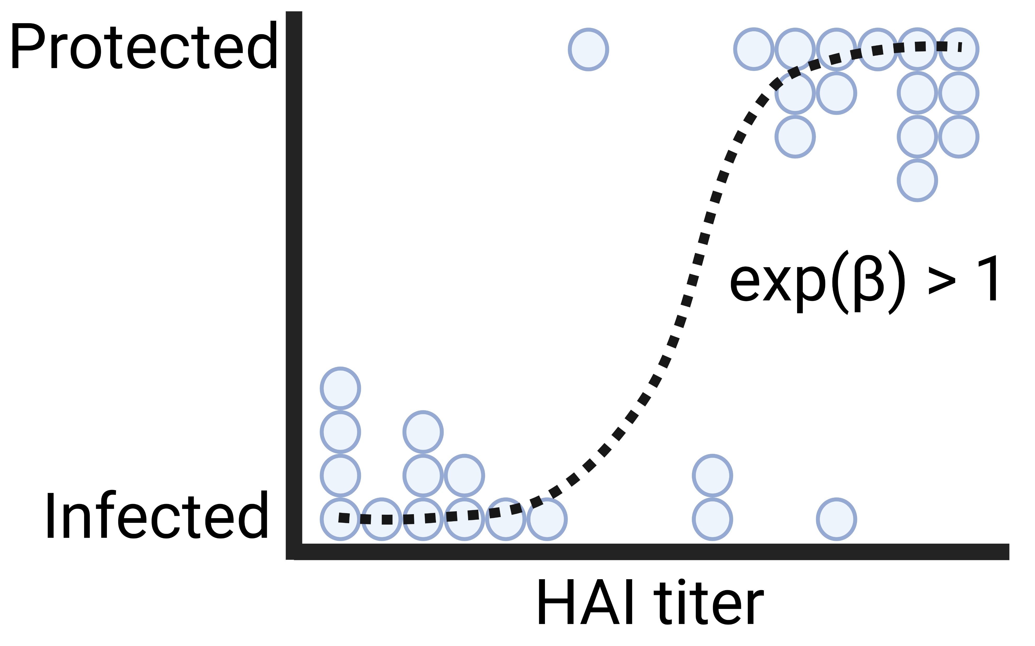

Slide 46
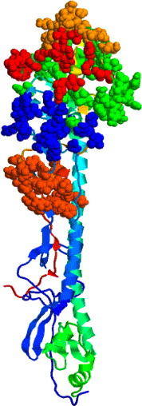
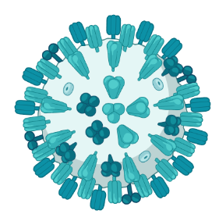
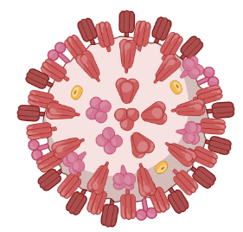
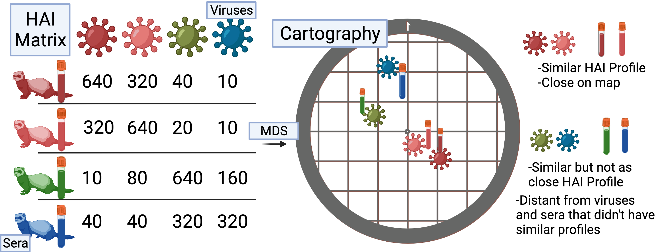
Calculating Ag distance
(dominant) p-Epitope method
Temporal method
A/H3N2/Aichi/2/1968
MKTIIALSYIF
MLTIIKLSYLF
|2017 – 1968| = 49
Hamming distance = 3
p-Epitope = 3/11 = 0.27
(I made this sequence up)
A/H3N2/Kansas/14/2017
Antigenic cartography method
Protein structure from Gupta, Earl, and Deem. Vaccine 2006.
Cartography figure made by Amanda Skarlupka.

Slide 47
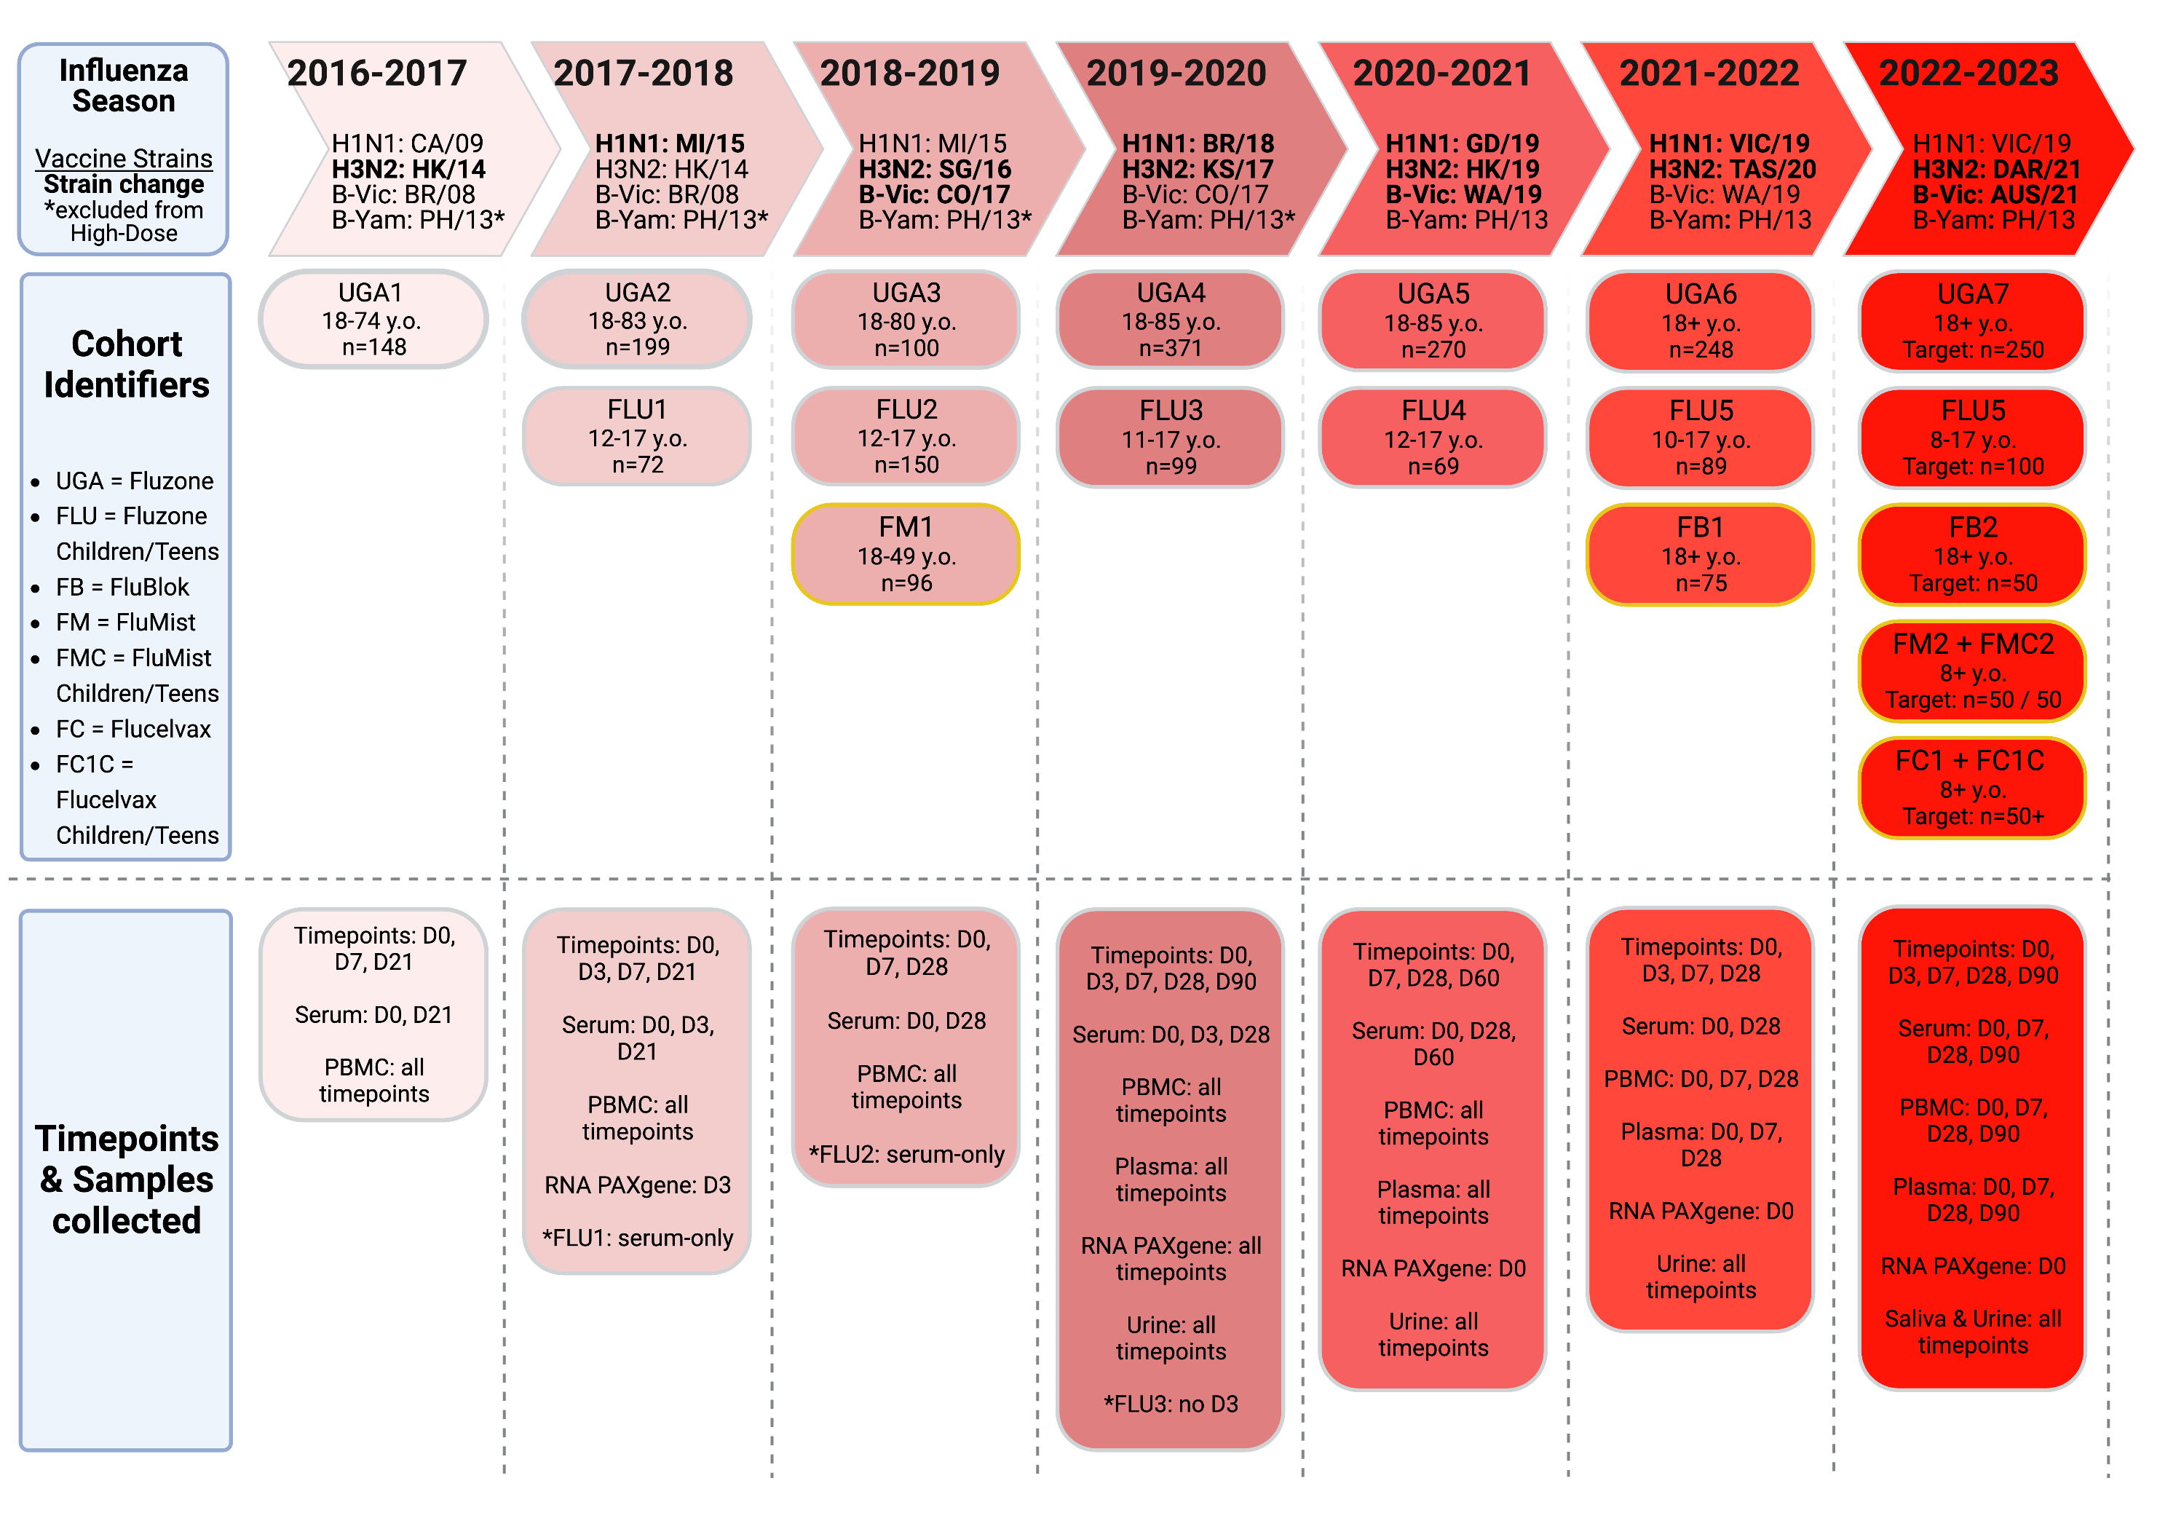
“UGAFluVac”: this, plus a similar study from 2013 – 2016 also by Ted Ross
Notes:
Brief intermission for data description

Slide 48
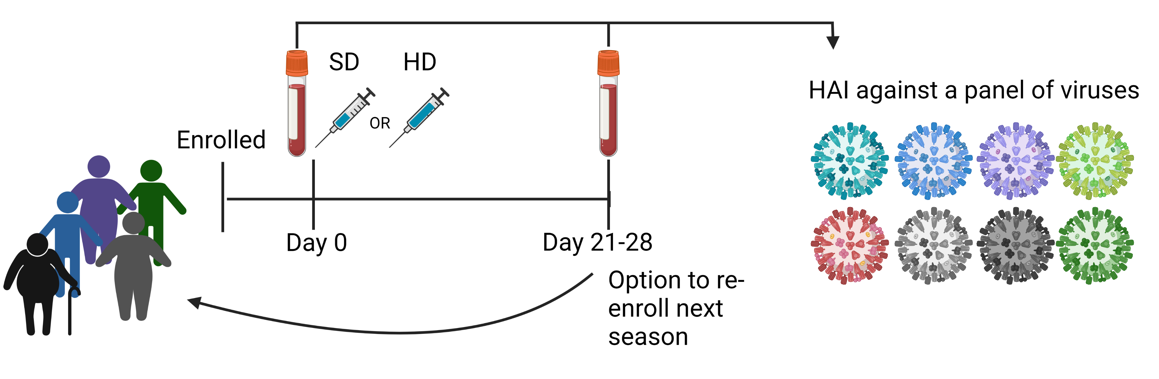
UGAFluVac conceptual figure. The design of RocFluVac was similar, but with
emphasis on diverse immunological measurements rather than heterologous
HAI panels. (Figure made by Amanda Skarlupka.)

Slide 49
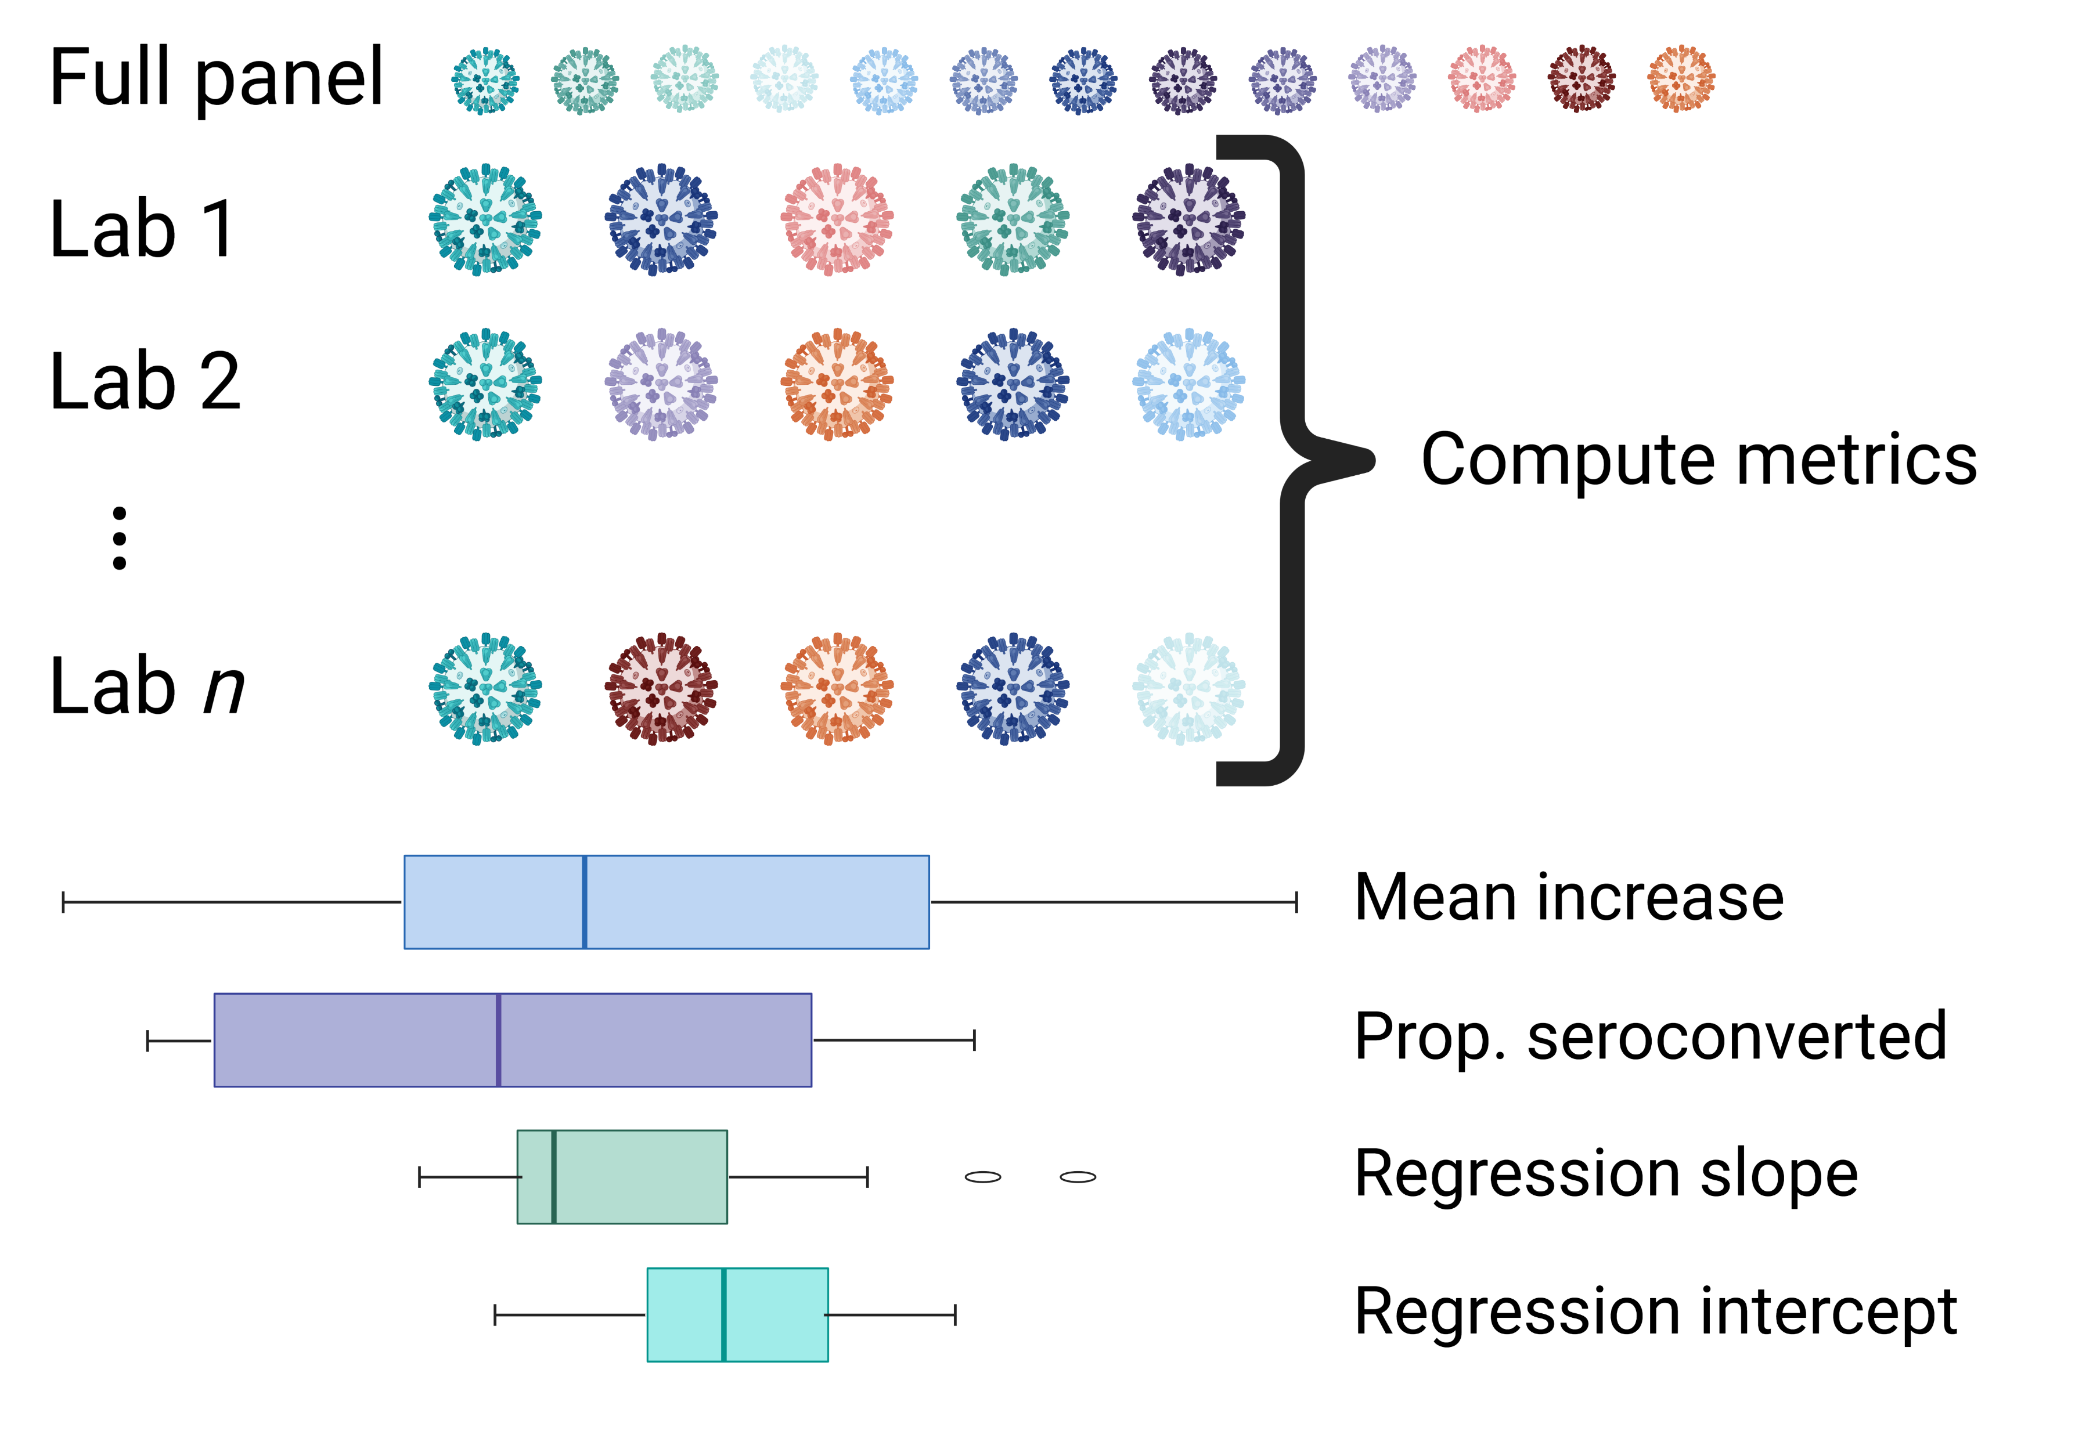
?

Slide 50
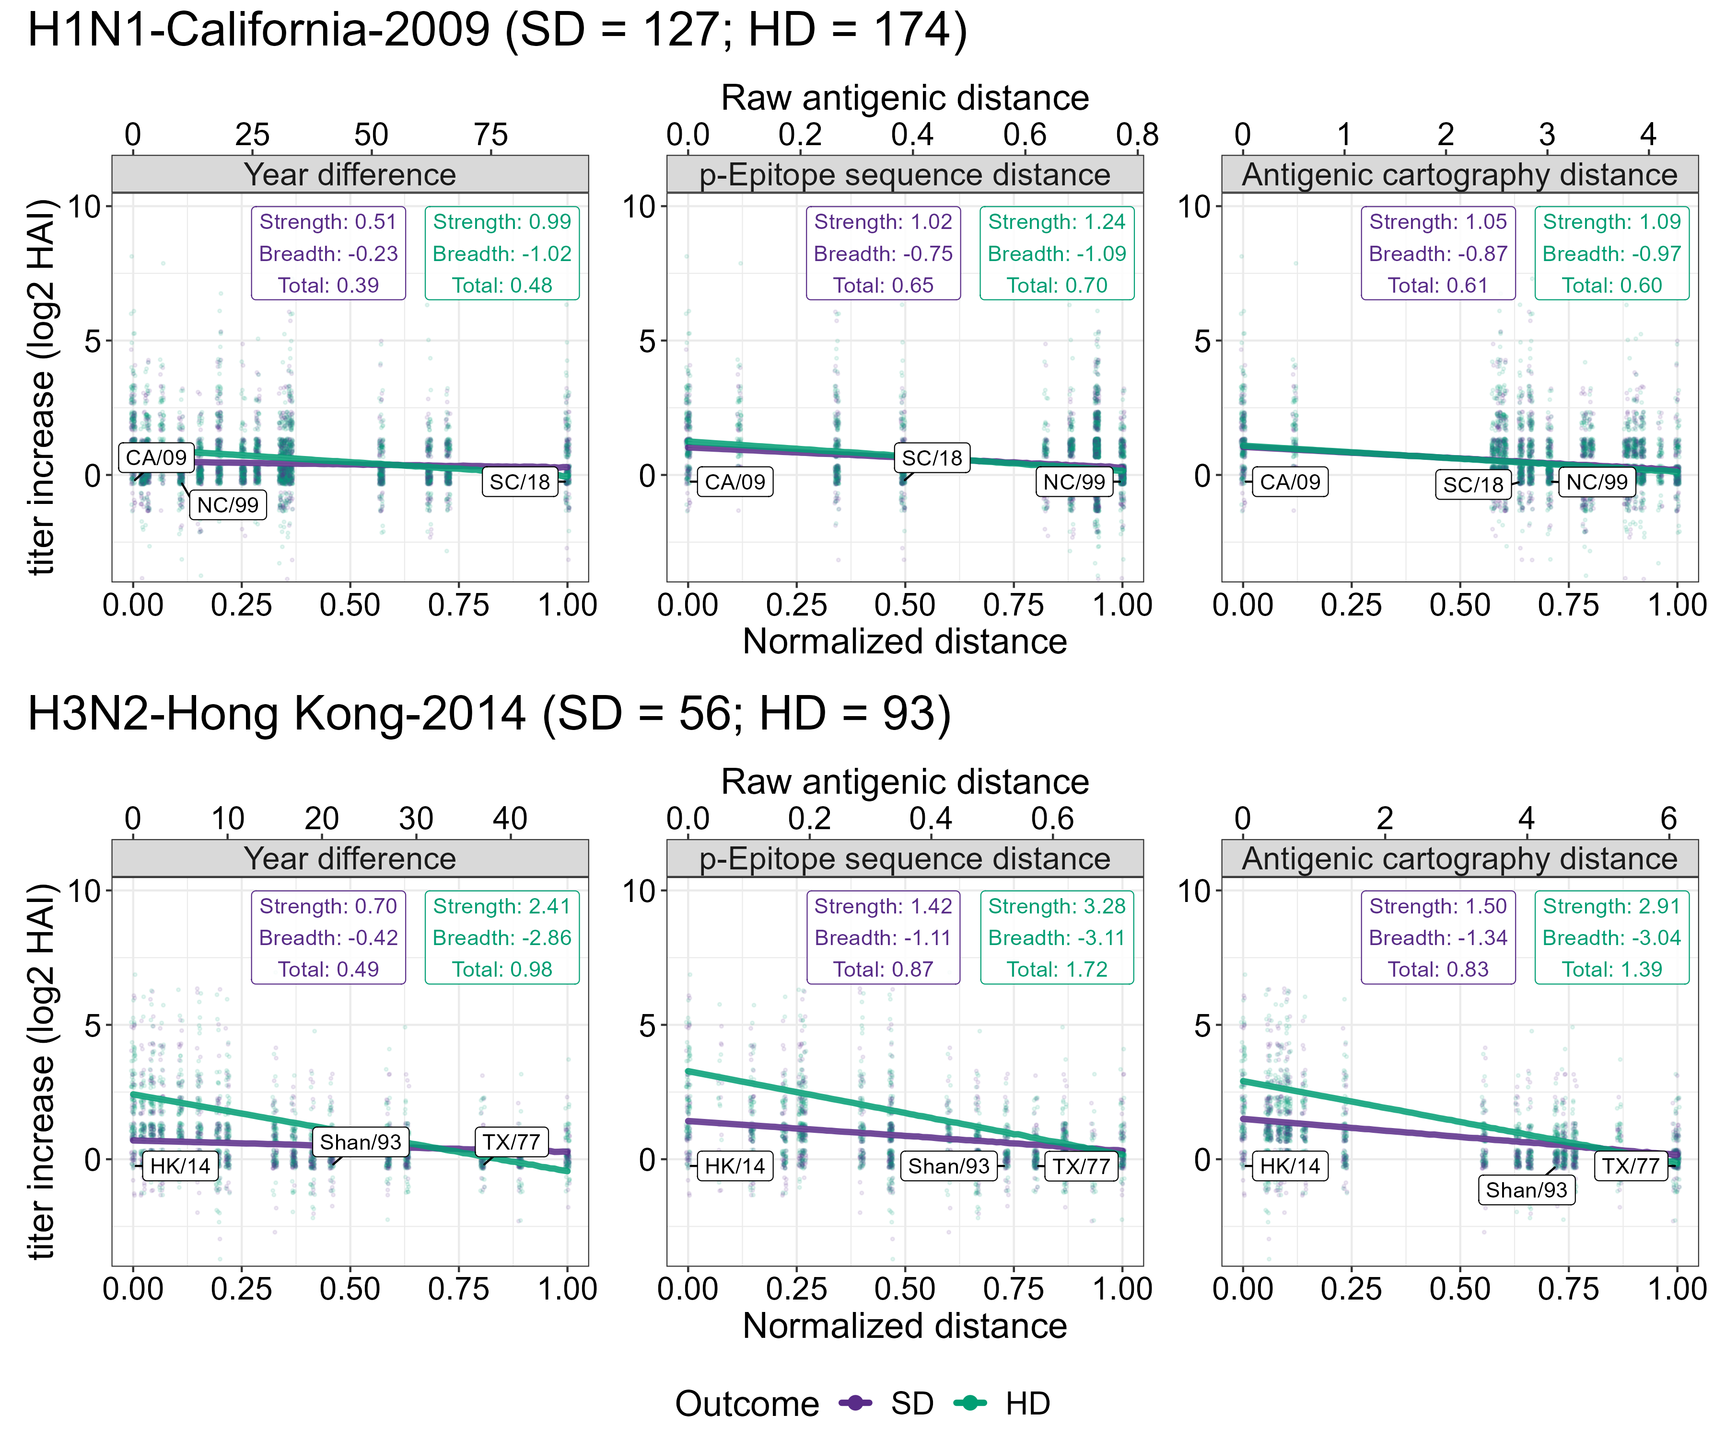

Slide 51
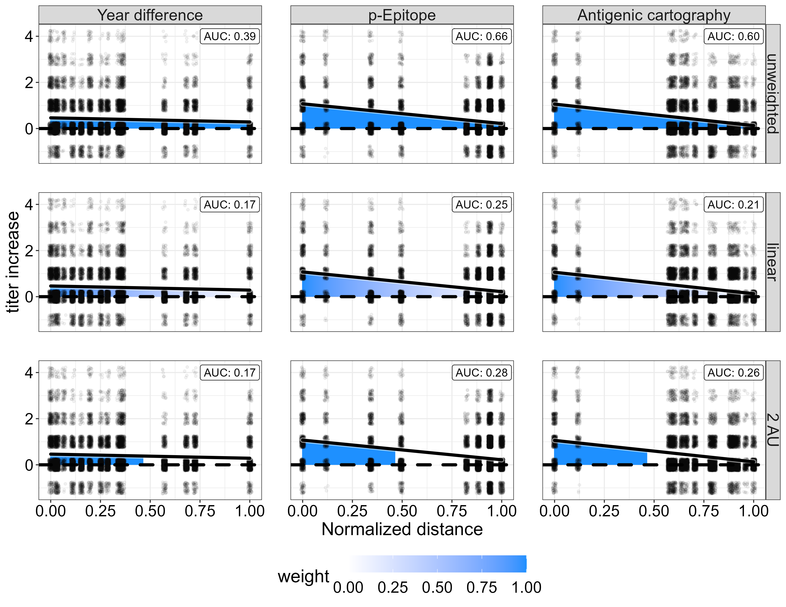

Slide 52
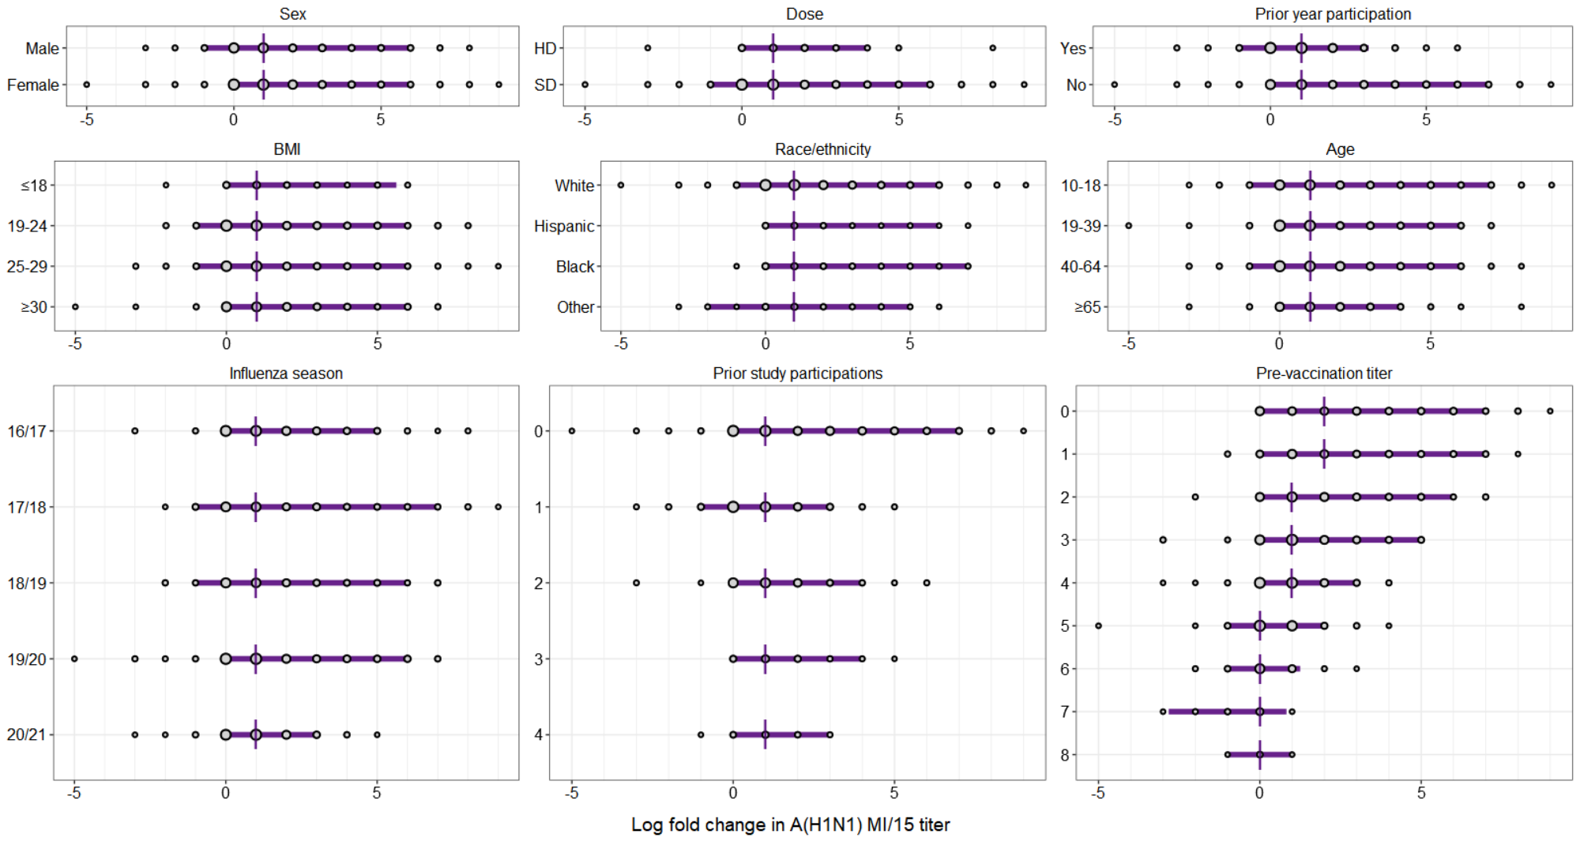

Slide 53
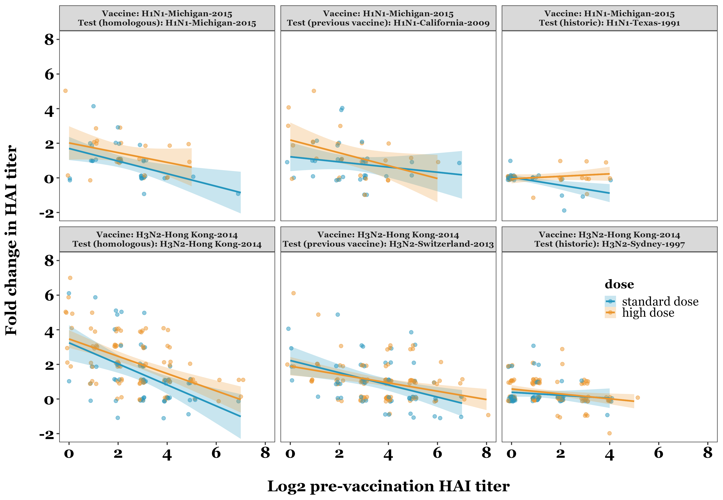
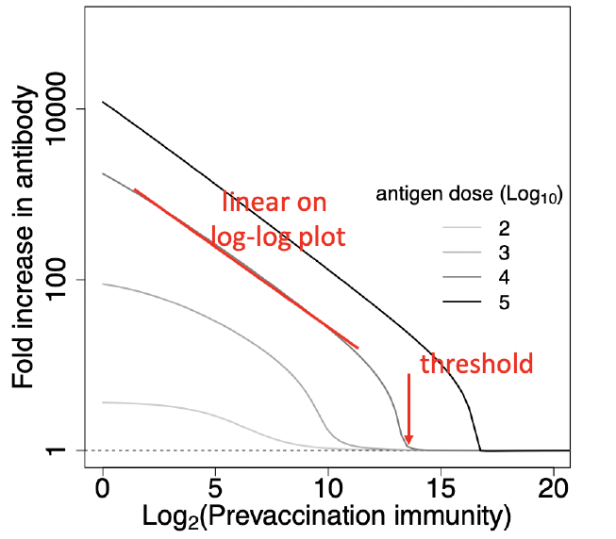
Fig from Zarnitsyna VI et al, PLoS Pathog, 2016.

Slide 54
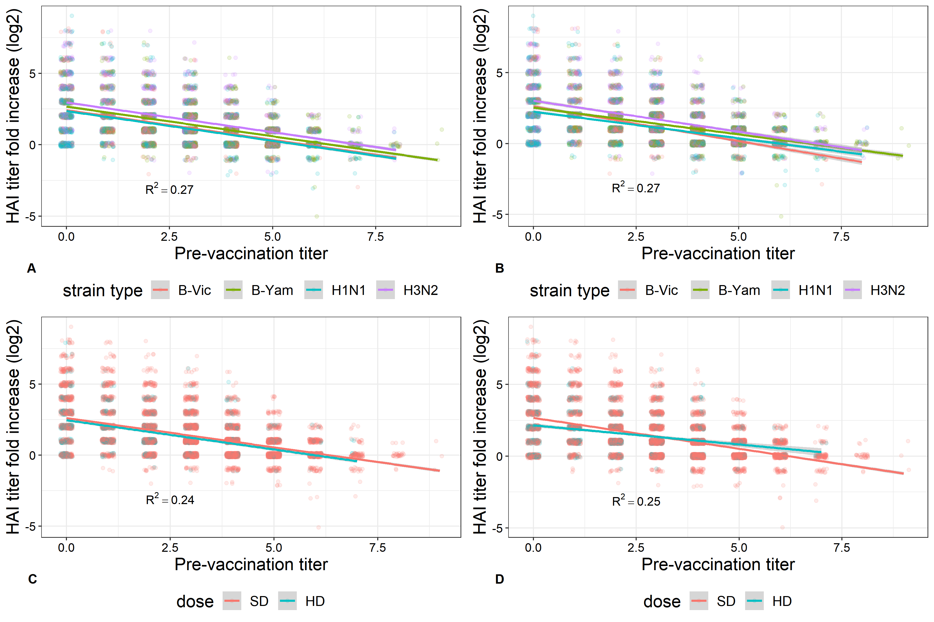

Slide 55
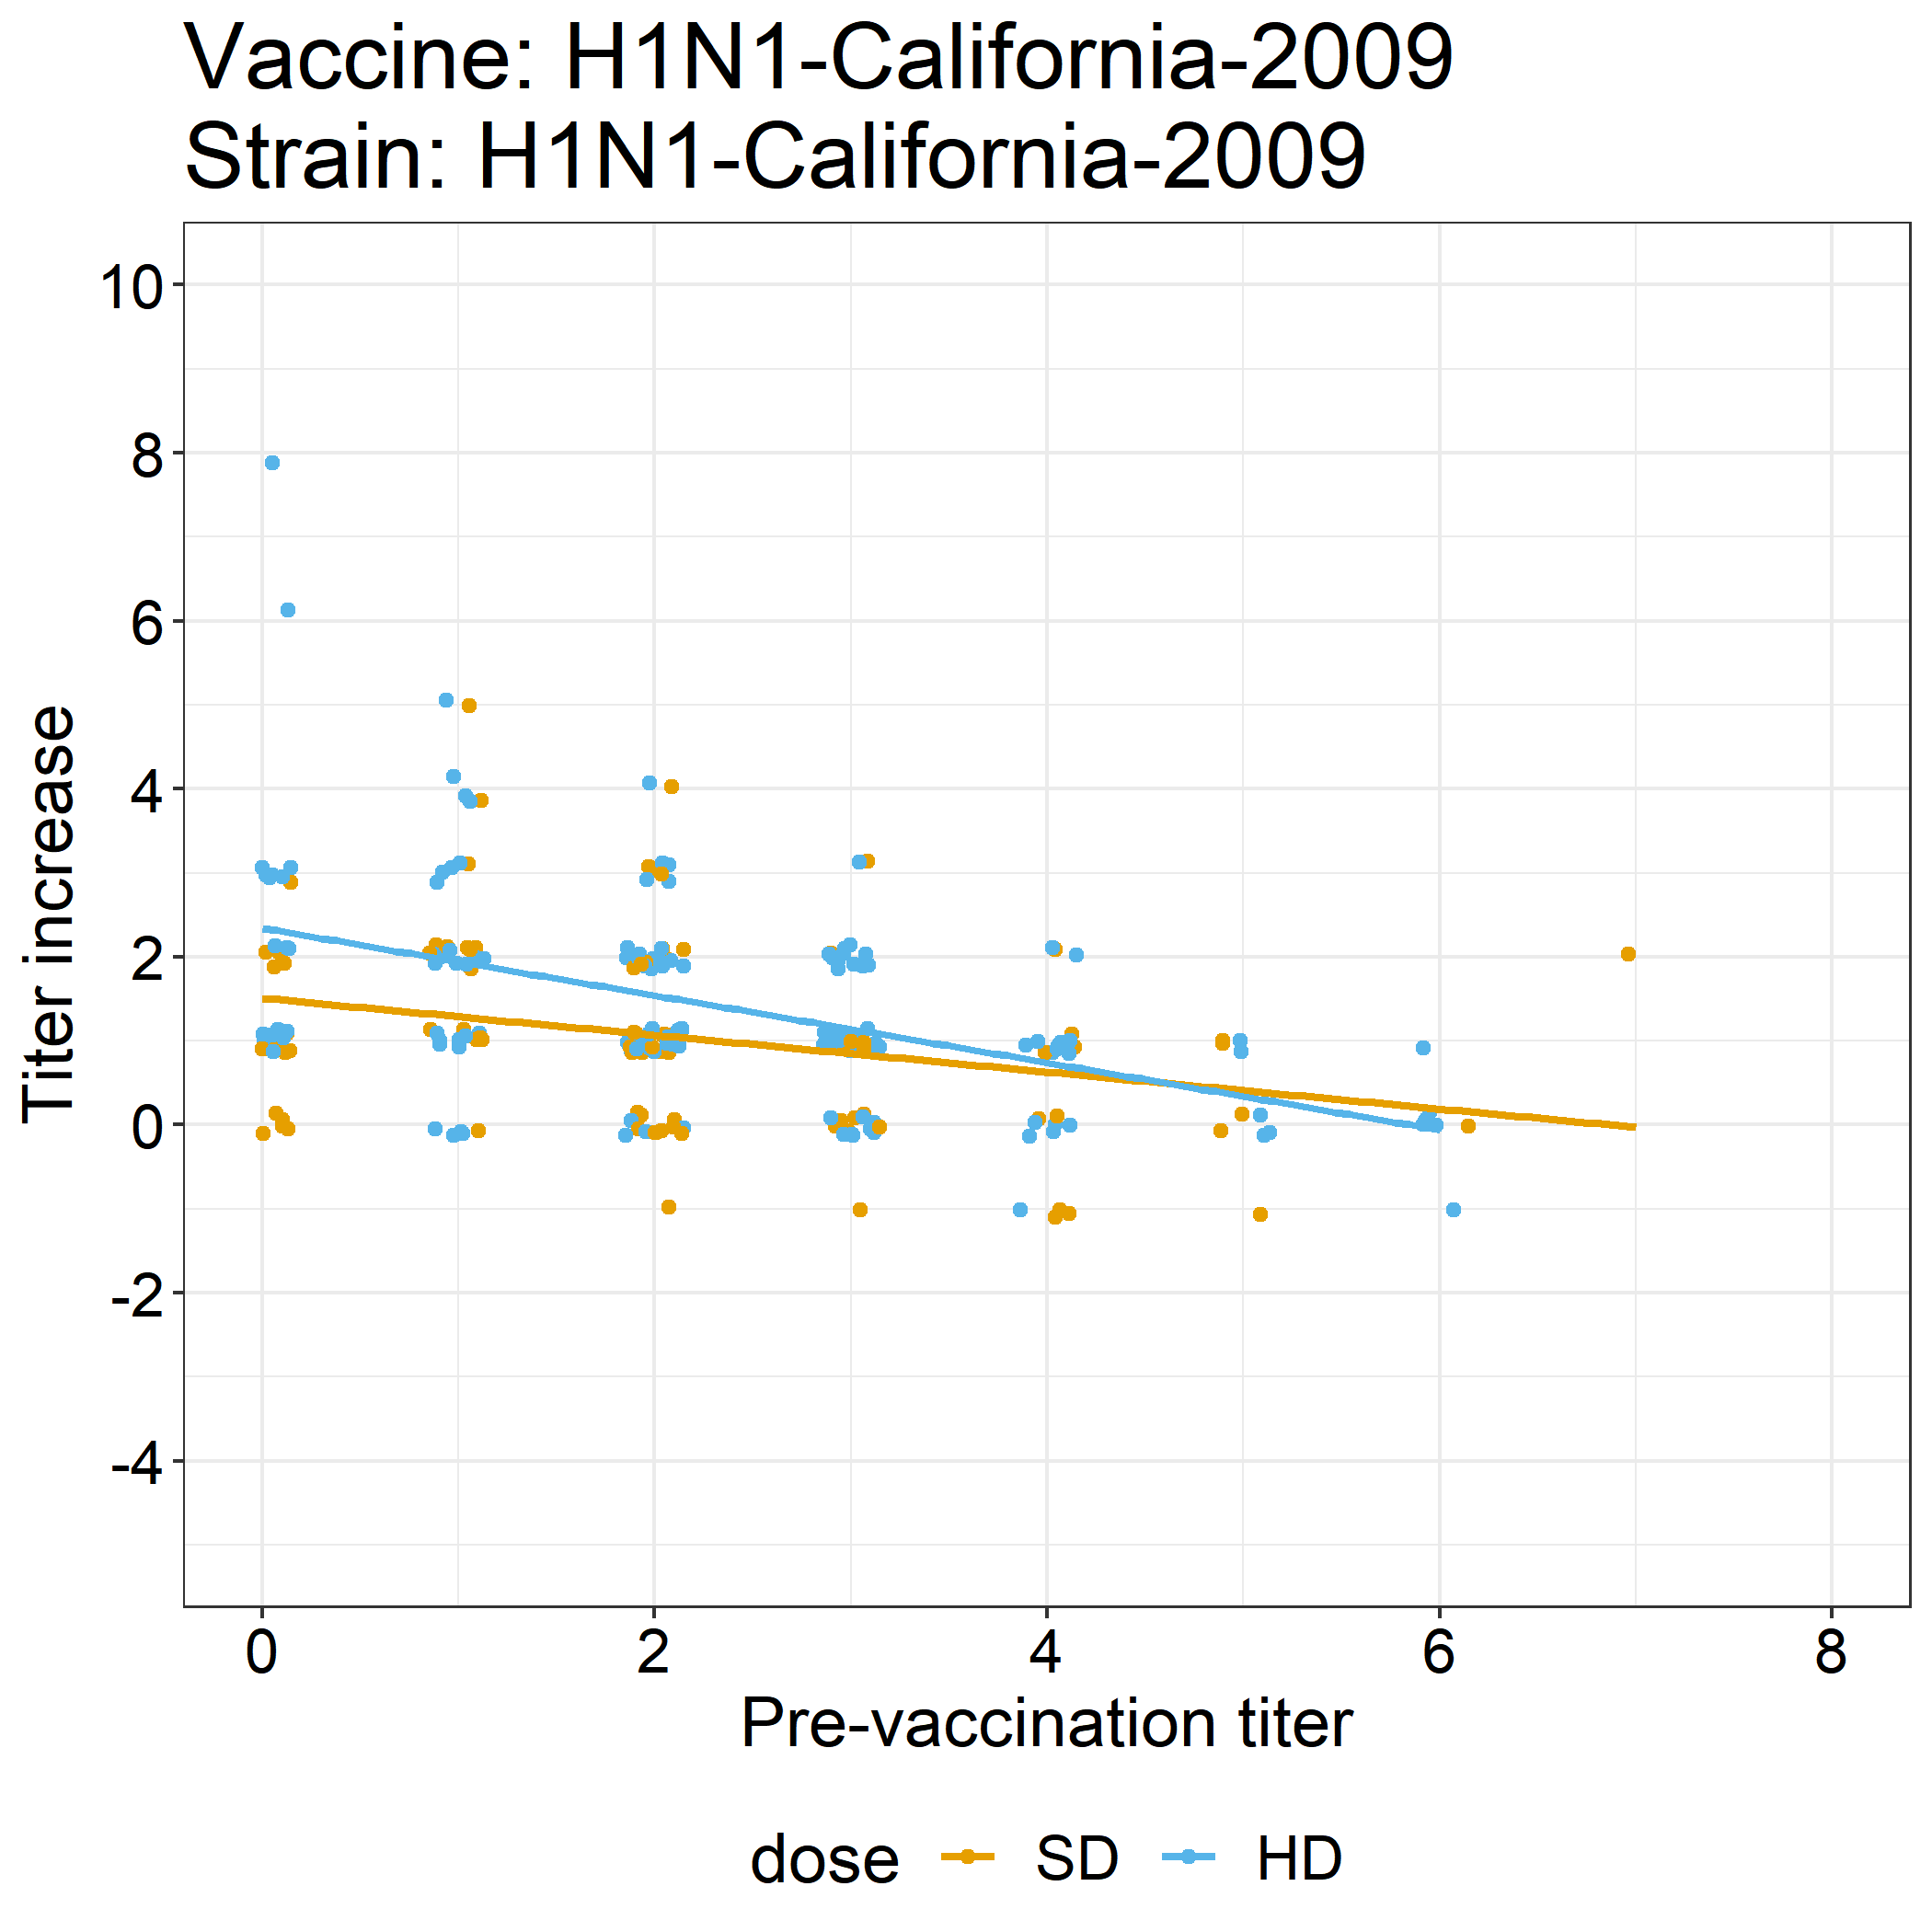
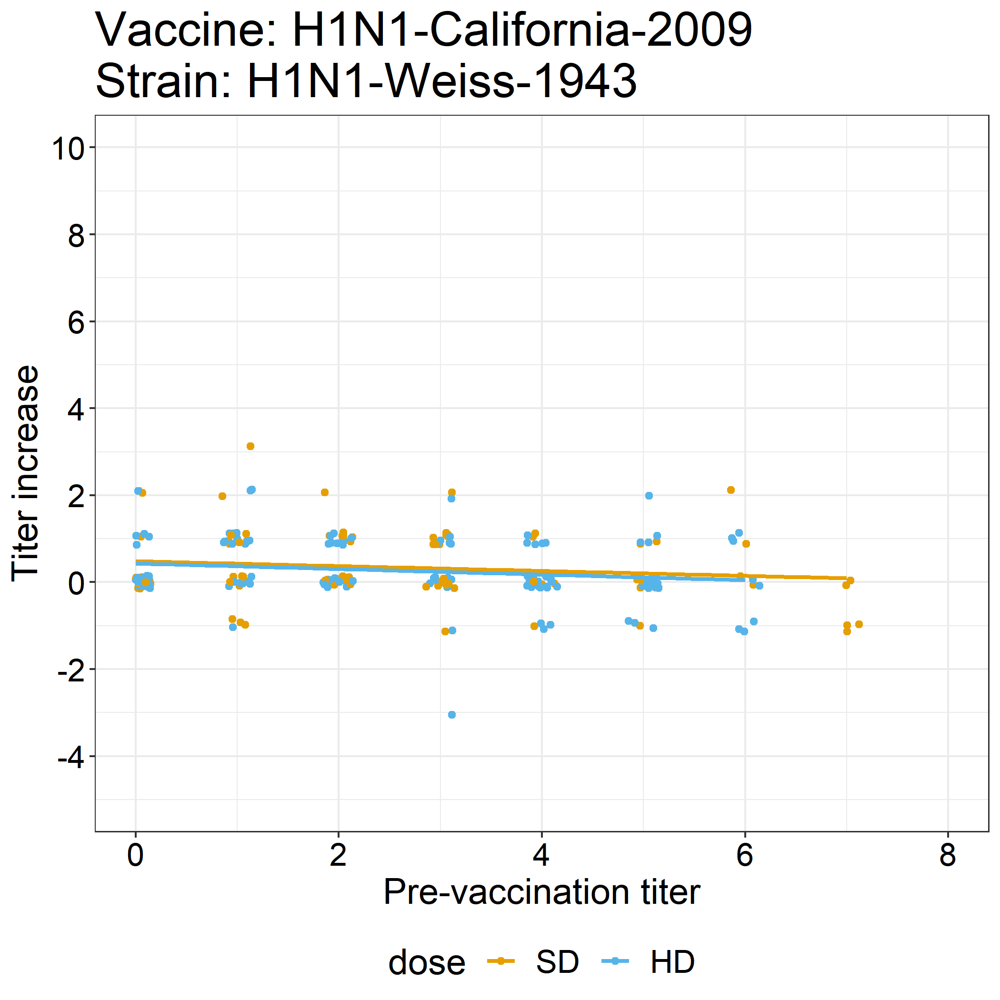

Slide 56



Slide 57


Slide 58


Slide 59


Slide 60


Our goal: can we do something here to add an amount of antigenic difference that controls the rate at which states occur, rather than parametrizing in terms of steric hindrance?
Zarnitsyna et al, PLOS Path 2016

Slide 61


Slide 62


